Slide 1

PROMOTION AND EFFECTIVE ENGAGEMENT OF TOURISM-RELATED PPP (Public Private Partnership)
FOR ECONOMIC GROWTH
‘24
SAINT PETERSBURG
SAINT PETERSBURG

Slide 2
THE MAIN INDICATORS OF THE TOURIST FLOW
SAINT PETERSBURG
Indicators of the state program "Development of the tourism sector in St. Petersburg" in 2023.
Main indicators of tourist flow in St. Petersburg in 2019-2023 and the first half of 2024.
1
2
3
4
5
6
100%
+16,3%
-72,1%
+33,1%
+109,3%
1
Tourism share in GRP (Gross Regional Product)
The number of tourists in St. Petersburg
Growth rate of tourist arrivals to St. Petersburg (annually, average for the period)
2
3
4
Number of overnight stays in hotels and similar accommodation facilities, mln
Hotel room stock utilisation ratio
The satisfaction level of citizens in the Russian Federation with the quality of tourism services in St. Petersburg
5
6
1st half of 2023
1st half of 2024

Slide 3
EMPLOYMENT IN THE TOURISM SECTOR IN ST. PETERSBURG
SAINT PETERSBURG
Employment structure of those directly employed in the tourism sector of St. Petersburg
+10%
Tourism employment growth rate,
annually
Multiplier in the tourism industry
The workplace in the city is related to the tourism sector
Travel Agencies
Congress and Exhibition Companies
3.5
Tour Operator Companies
12th
Tour Guides
Average number of employees in the tourism industry in Russia, mln. people
Average number of employees in the tourism industry in St. Petersburg, thousand people
220 thousand people*
Hospitality Industry
* considering the multiplier

Slide 4
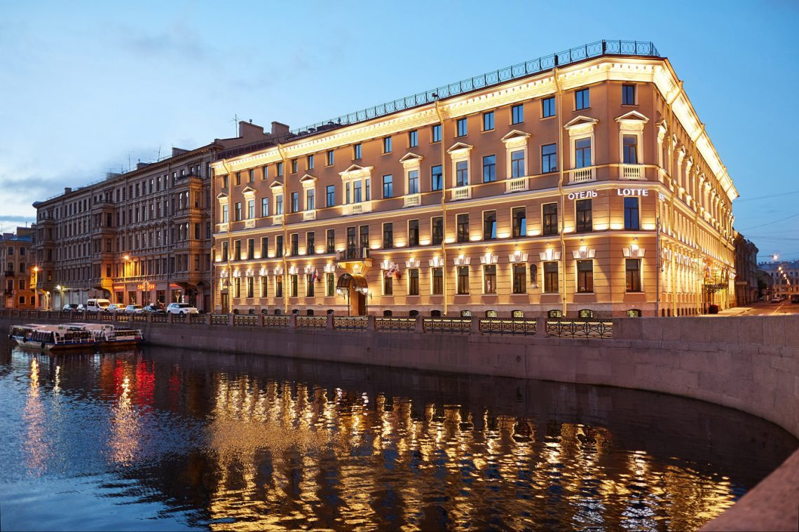



ACTIVITIES OF COLLECTIVE ACCOMMODATION FACILITIES (CAF)
SAINT PETERSBURG
Classified CAFs
1,200 hotels and 52,400 rooms
Unclassified CAFs
Structure of room stock BUILT IN 2023
2023 (actual)
2023 (actual)
7
Opened classified accommodation facilities
2
Opened unclassified accommodation facilities
1622
Rooms in the new CAFs
1488
Rooms in the new CAFs
Hotels
Apartments
2024 (prognosis)
2024 (prognosis)
Structure of room stock BUILT IN 2024
5
Classified accommodation facilities
13
Unclassified accommodation facilities
752
Rooms in the new CAFs
5514
Rooms in the new CAFs
THE RESORT FEE in 2024
130 mln RUB
Effective Region Program:
"Modelling the process of introducing a resort fee in the territory of St. Petersburg using the principles and tools of "lean" production
Hotels
Apartments

Slide 5
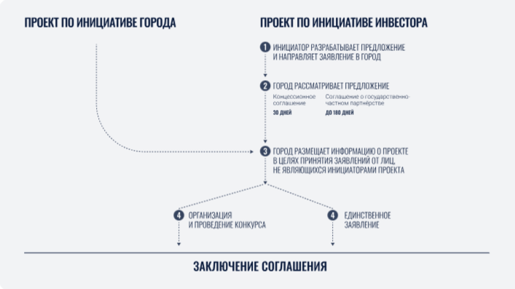
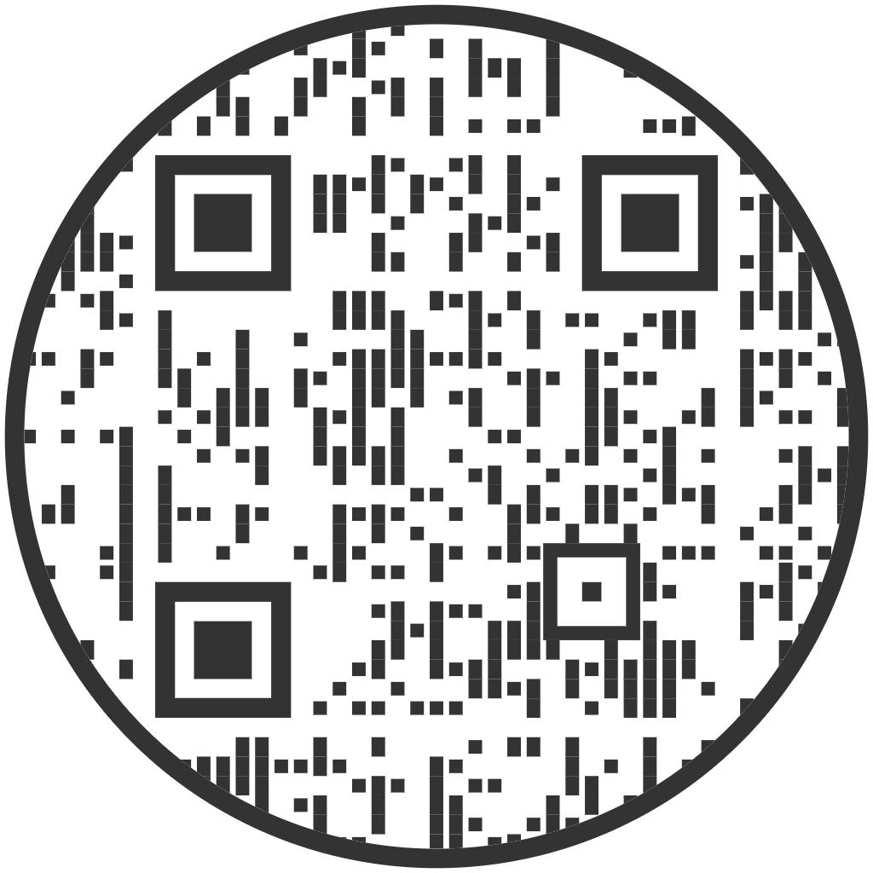
Agreement procedure for PPP implementation
SAINT PETERSBURG
CITY INITIATIVE PROJECT
INVESTOR-INITIATED PROJECT
THE INITIATOR DEVELOPS A PROPOSAL AND SUBMITS THE APPLICATION TO THE CITY
RUB 1,195.6 bln of investments
THE CITY CONSIDERS THE PROPOSAL
Regional investment standard
Concession agreement
30 DAYS
Public-Private Partnership Agreement (PPPA)
UP TO 180 DAYS
THE CITY POSTS INFORMATION ABOUT THE PROJECT IN ORDER TO ACCEPT APPLICATIONS FROM PERSONS OTHER THAN THE INITIATORS OF THE PROJECT
CONTEST ORGANIZATION AND HOLDING
SINGLE APPLICATION
CONCLUSION OF THE AGREEMENT
St. Petersburg Investment Portal
spbinvestment.ru

Slide 6

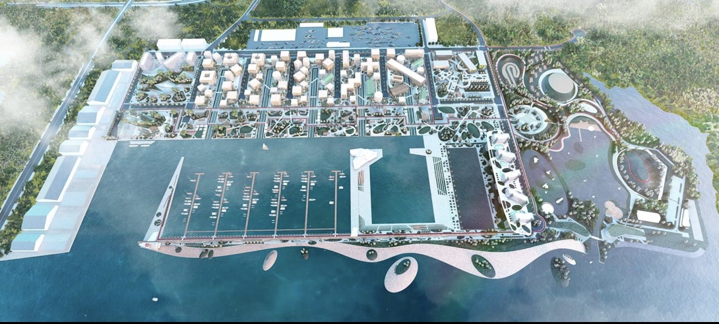
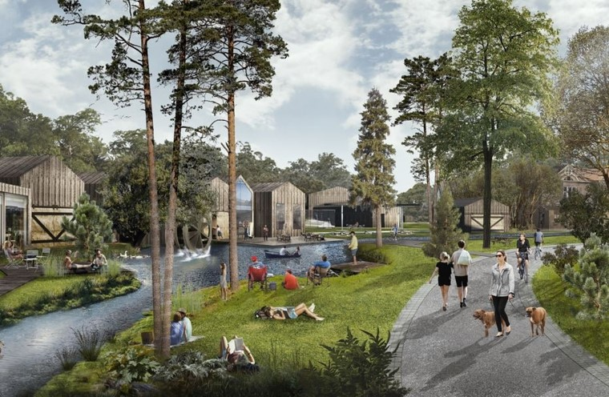
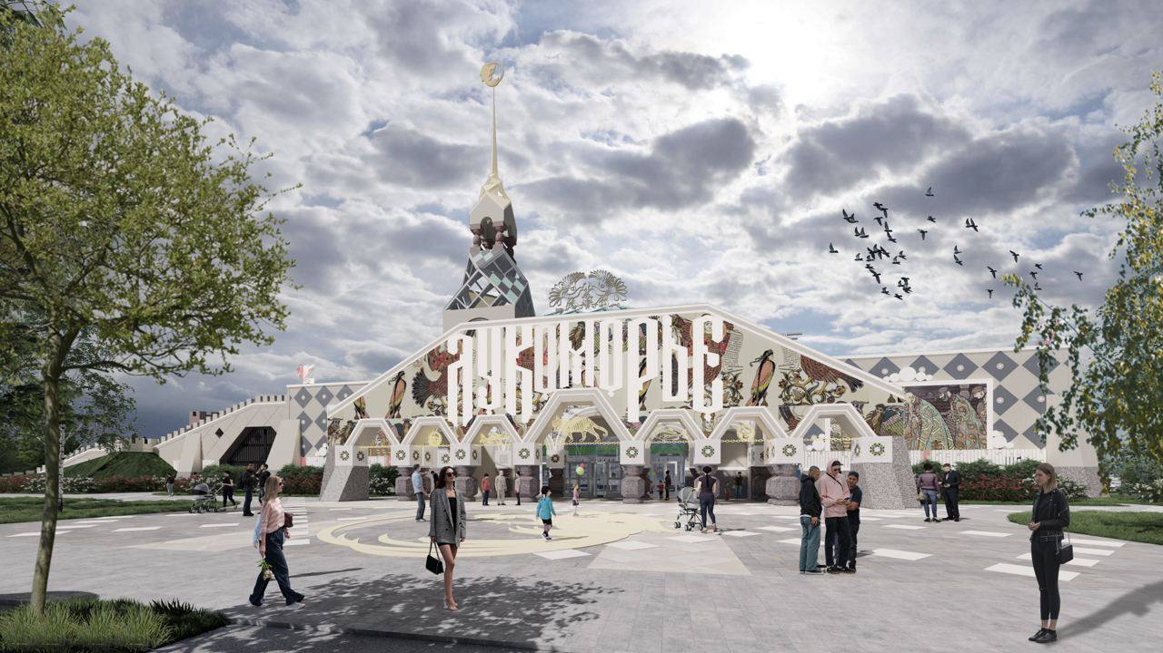
INVESTMENT PROJECTS IN THE TOURISM AND HOSPITALITY INDUSTRY
SAINT PETERSBURG
It is being implemented in St. Petersburg:
15
CULTURAL AND LEISURE CENTERS
7
Gorskaya tourist and recreational cluster
520a, Primorskoye shosse, Zelenogorsk
Pushkin's Fairy Tales Park "Lukomorye"
HOTEL INVESTMENT PROJECTS
29.5 ha area
400 berthing places
2 km artificial beach line
2000 rooms
1.33 million people expected tourist flow
1 hotel
2 camping
cultural and entertainment facilities
sports facilities
RUB 11.5 bln of investments
120 rooms hotel 4*

Slide 7
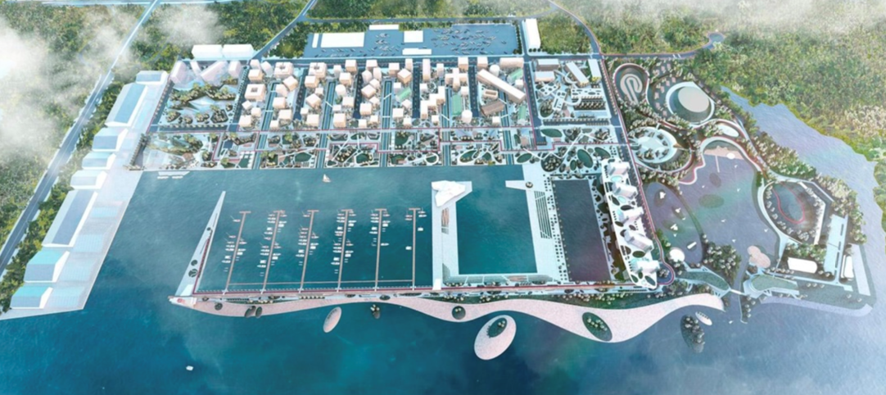
Integrated tourist project "St. Petersburg - Marina ("Gorskaya")
New tourist attraction point on the Baltic Sea
The area of the territory is more than 130 hectares
An all-season sea resort with Russia's largest modern yacht marina in the Primorsky district of St. Petersburg

Slide 8
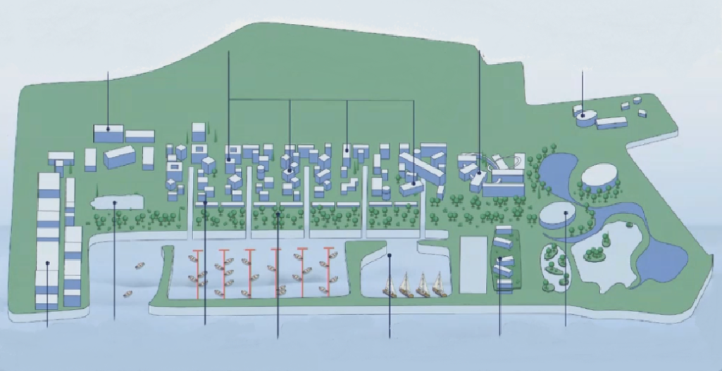
Integrated tourist project "St. Petersburg - Marina ("Gorskaya")
Hotels
Movie studio
Business Center
Education Center
Historical shipyard "Poltava"
Promenade
Yacht service hub
Yacht marina
Yacht club
Sports and social cluster
Restaurants
Hotel complex, spa

Slide 9
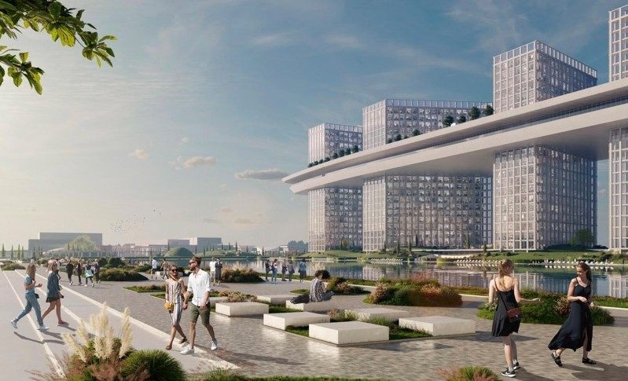
Integrated tourist project "St. Petersburg - Marina ("Gorskaya")
The project is included in the list of creation of new year-round sea resorts on the territory of the Russian Federation
Supporting infrastructure being built
Total investment volume
RUB 200 bln.

Slide 10
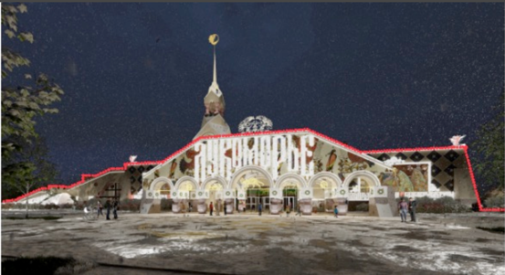
Complex tourist project "The Theme Park of Pushkin's fairy tales "Lukomorye” (Strategic Project)
Construction of an amusement park - interactive center of A.S. Pushkin's fairy tales "Lukomorye" and a 4* hotel offering 120 rooms in the town of Pushkin.

Slide 11
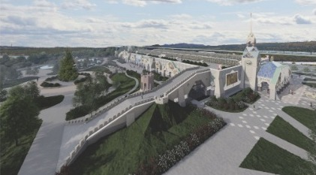
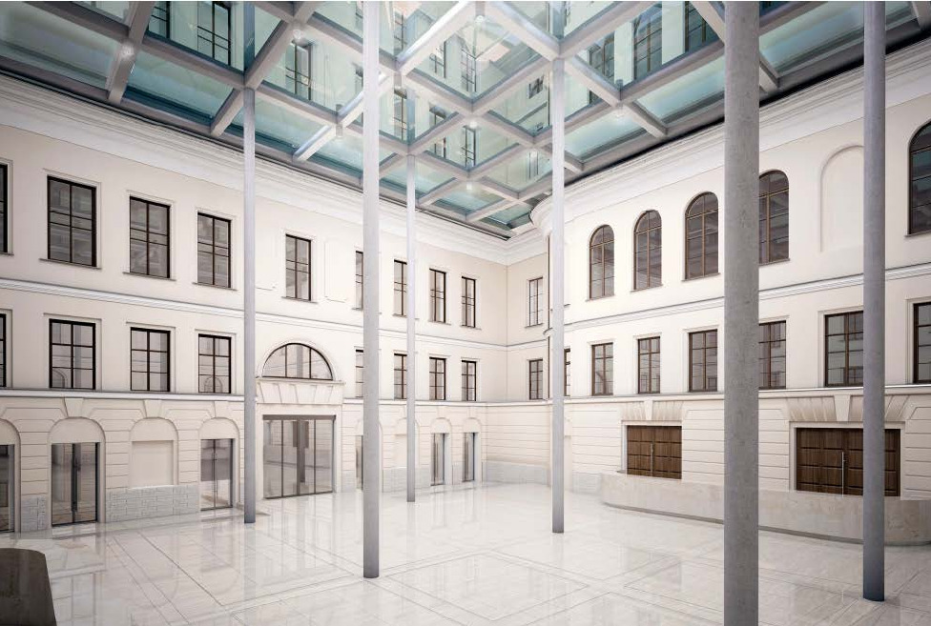
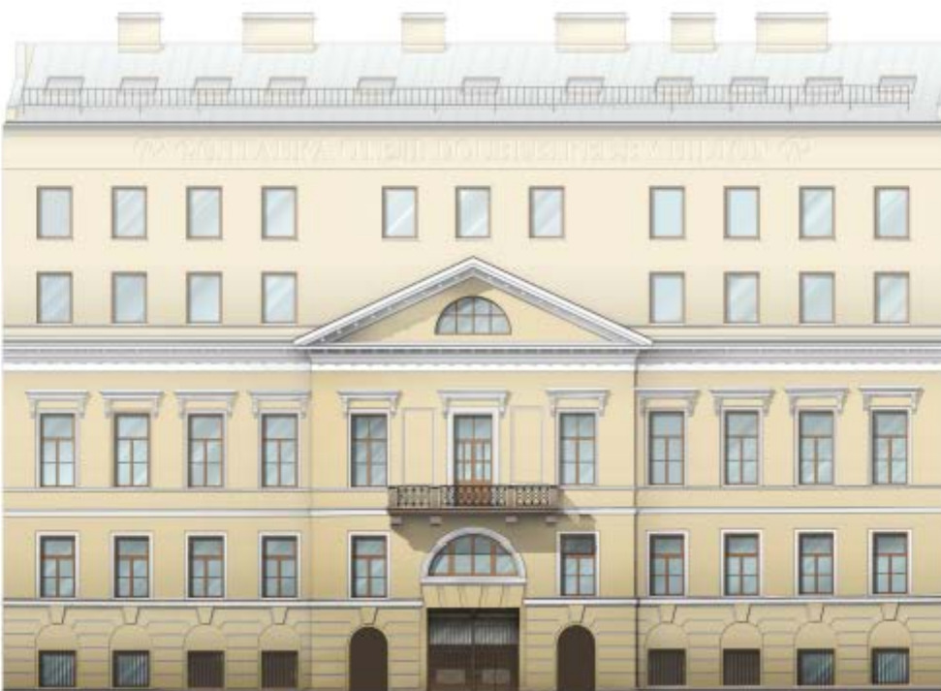
Complex tourist project "The Theme Park of Pushkin's fairy tales "Lukomorye"
Project type - new construction
The area of land plots is 11.5 hectares
Room stock - 120 rooms

Slide 12
Creation of a hotel and leisure complex
520 a, Primorskoye shosse, Zelenogorsk, St. Petersburg
(PPP Project)
The area of the territory no less than 7745 square metres
The project involves the reconstruction and operation of a facility for the provision of recreation and tourism for the public

Slide 13
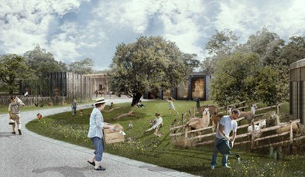
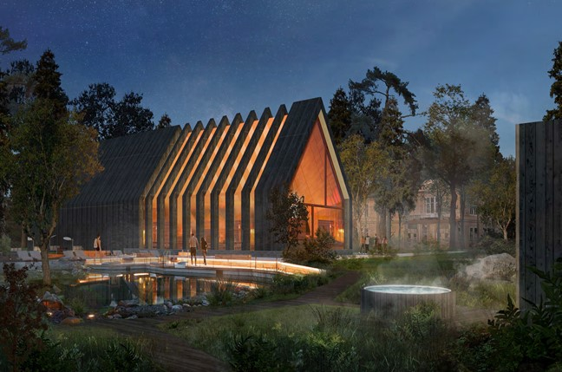
Creation of a hotel and leisure complex
520 a, Primorskoye shosse, Zelenogorsk, St. Petersburg
The total number of rooms of the hotel facility - not less than 45 units.

Slide 14
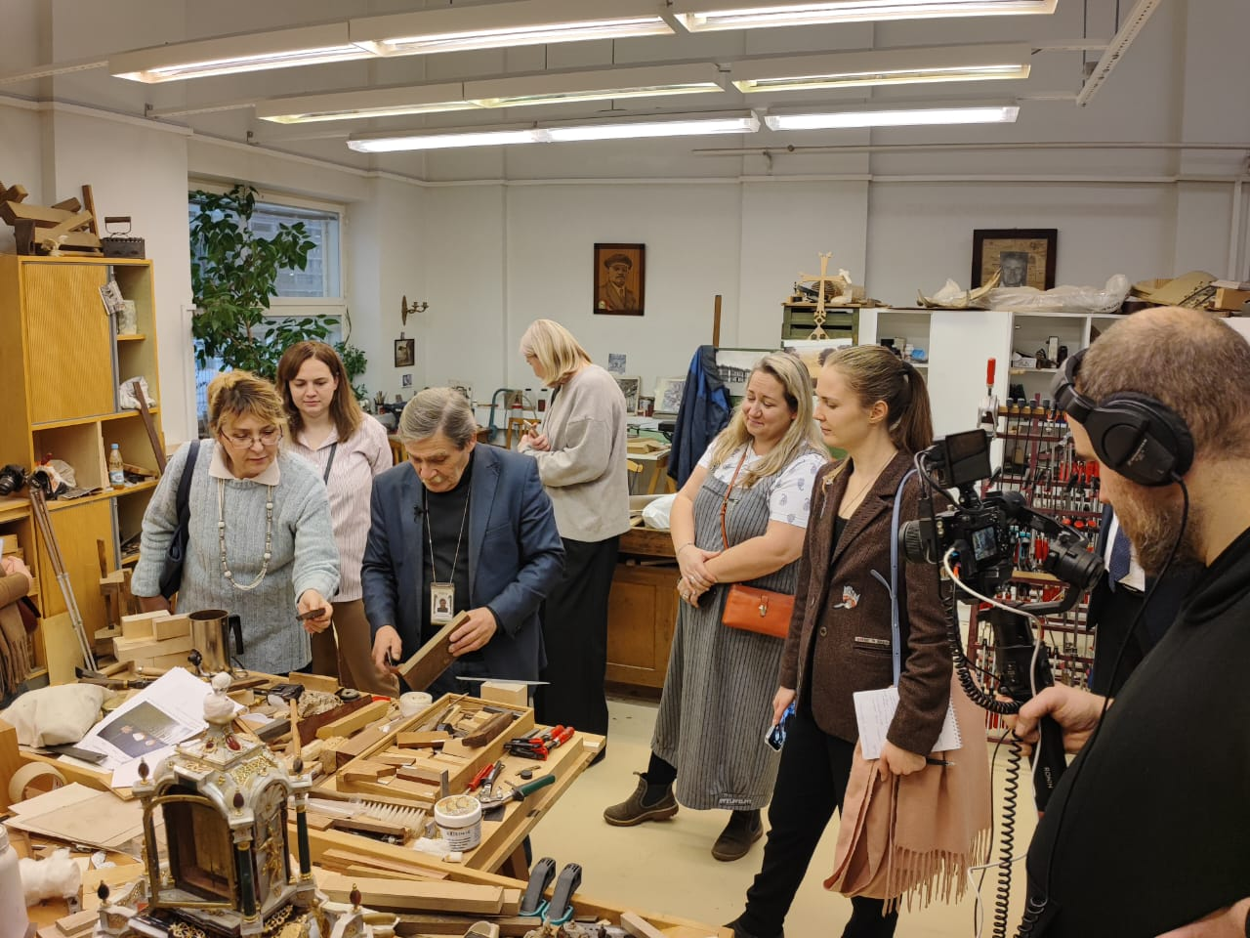
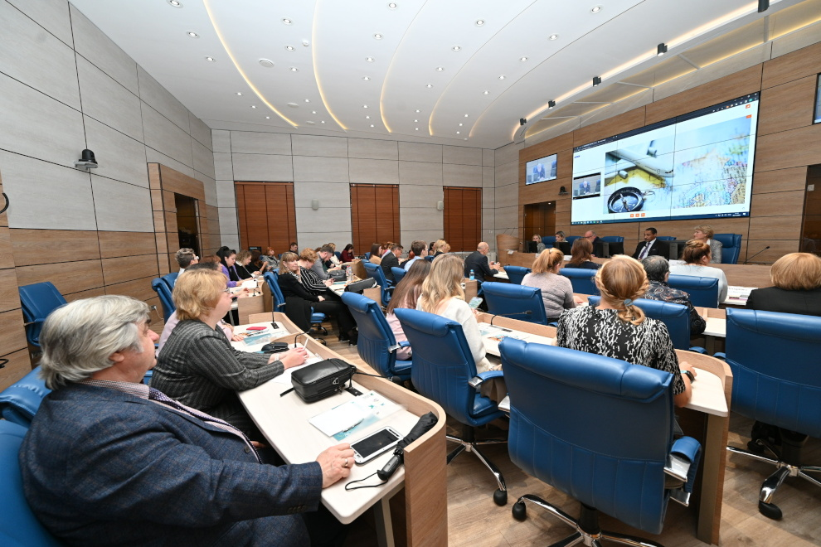
ACTIVITIES OF THE COMPETENCE CENTER IN THE FIELD OF TOURISM AND HOSPITALITY
SAINT PETERSBURG
protocols on cooperation with educational institutions:
CIS
Belarus
Uzbekistan
Azerbaijan
Kyrgyzstan
Tajikistan
BRICS+ Russian regions
India
The Republic of Cuba
In progress: China, Vietnam, etc.
REGIONAL FINANCING - RUB 5 mln.
FEDERAL FINANCING - RUB 95 mln.
Formation of innovative educational environment for upgrading and training of tourism and hospitality personnel for the tourism and education cluster on the basis of Russian software
trainees who have successfully completed the training
9
advanced training programs
1500
A draft sectoral qualification framework has been developed and approved by the Ministry of Economic Development and federal authorities.
3
104
trainees who have successfully completed the training
educational programs

Slide 15
ACTIVITIES of JSC "Saint-Petersburg Agency for Medical Tourism Development"
SAINT PETERSBURG
High-value treatment from the best doctors in the country
You contract directly with the clinic
Finding clinics for the treatment period.
All clinics undergo strict selection process
500k+
585
healthcare facilities
19 000
qualified doctors
foreign patients
A city management structure providing organization of medical services to foreign and domestic medical tourists on a reimbursable basis in St. Petersburg clinics

Slide 16
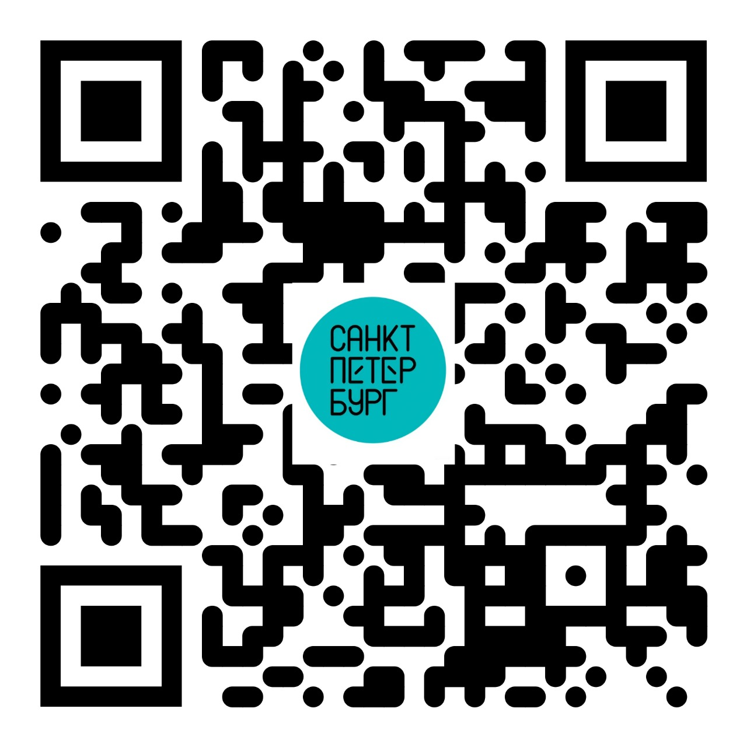

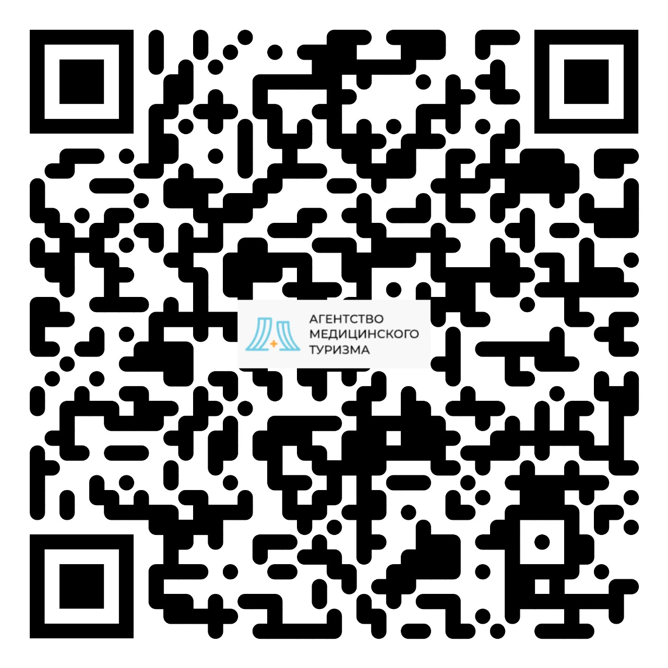
‘24
SAINT PETERSBURG
SAINT PETERSBURG
THANK YOU FOR YOUR ATTENTION!

