Slide 1



～The Home of Japan’s Number One Meat and Shochu～
Meat Tourism

Slide 2

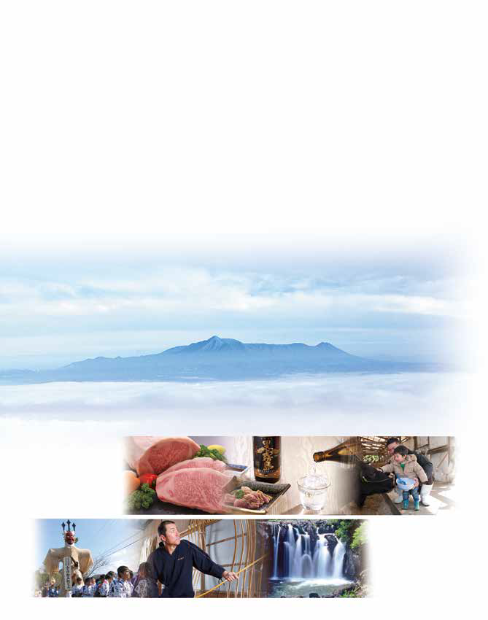

～The Home of Japan’s Number One Meat and Shochu～

Slide 3
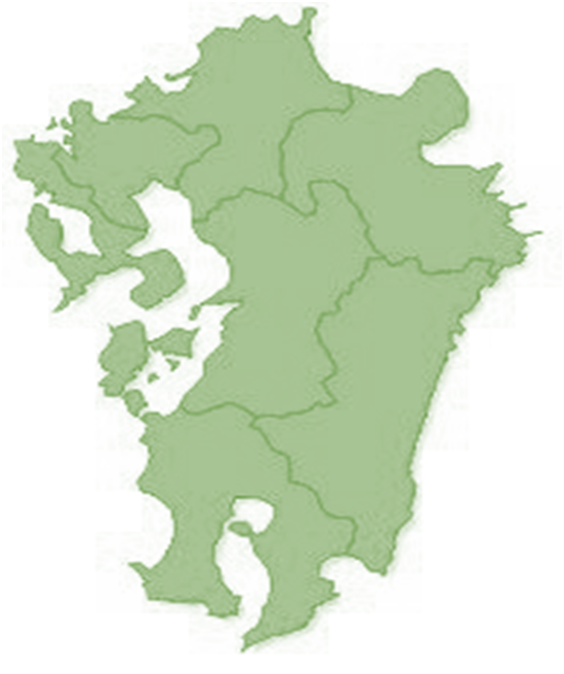




FUKUOKA
SAGA
OITA
KUMAMOTO
NAGASAKI
MIYAZAKI
MIYAZAKI PORT
KAGOSHIMA
AIRPORT
⚓
Car Travel-appx.
Fukuoka Airport - Miyakonojo City 3H 10min.
Kumamoto Airport – Miyakonojo City 2H 10min.
Miyazaki Airport - Miyakonojo City 50min.
Kagoshima Airport – Miyakonojo City 1H
KAGOSHIMA
Miyakonojo City
⚓
⚓
KAGOSHIMA PORT
⚓
ABURATSU PORT
SHIBUSHI PORT

Slide 4
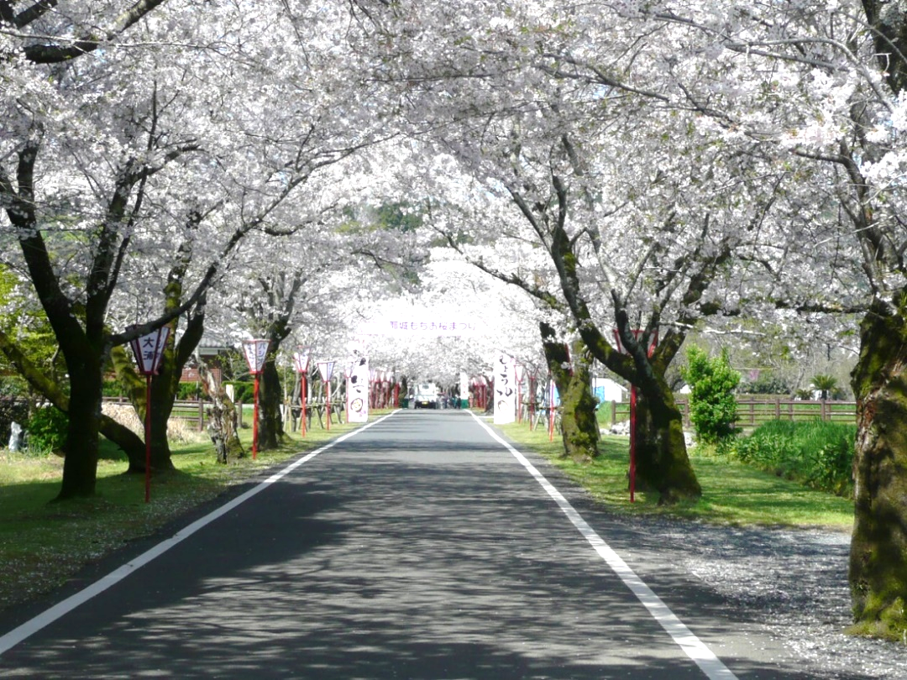

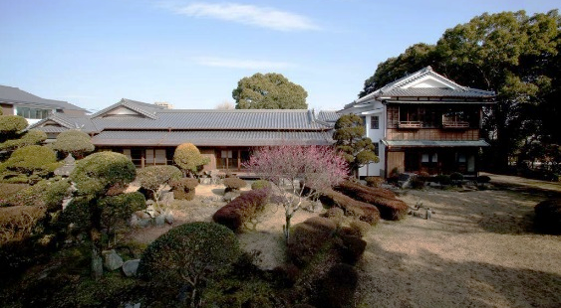
Miyakonojo is a town filled with treasured nature and tradition!
「Japan’s 100 Best Sakura Viewing Spots!」
Miyakonojo Shimazu Residence

Slide 5
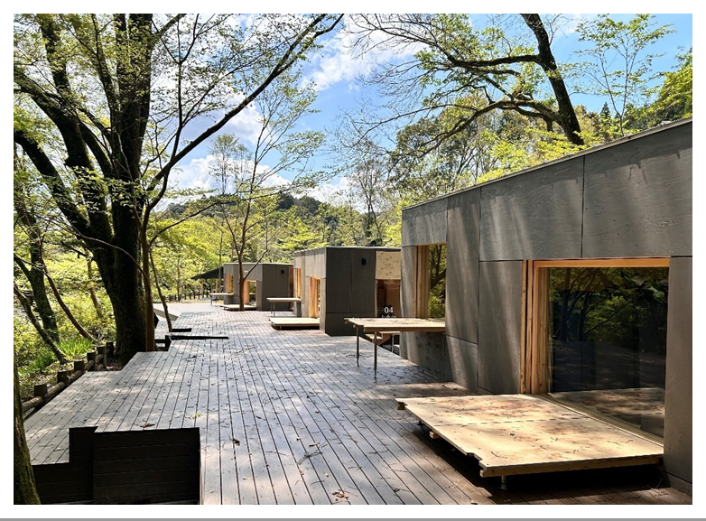
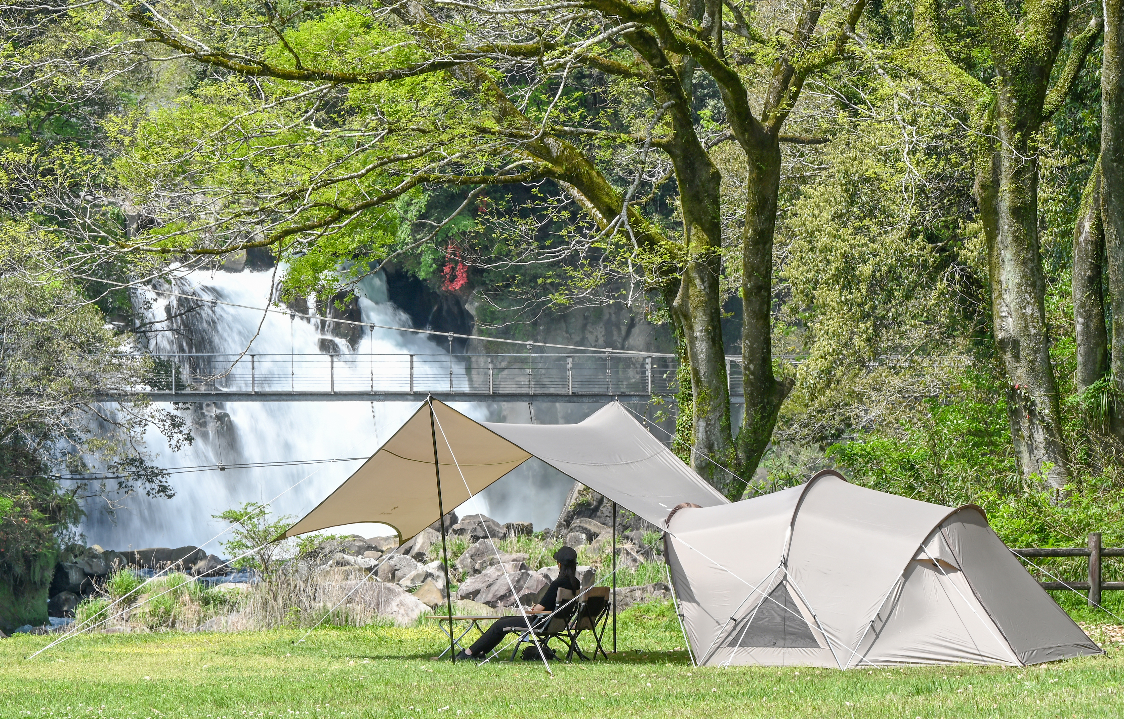
Sekinoo Falls
「Japan’s 100 Best Waterfalls!」
Mobile Home
「ＪＹＵＢＡＫＯ」

Slide 6
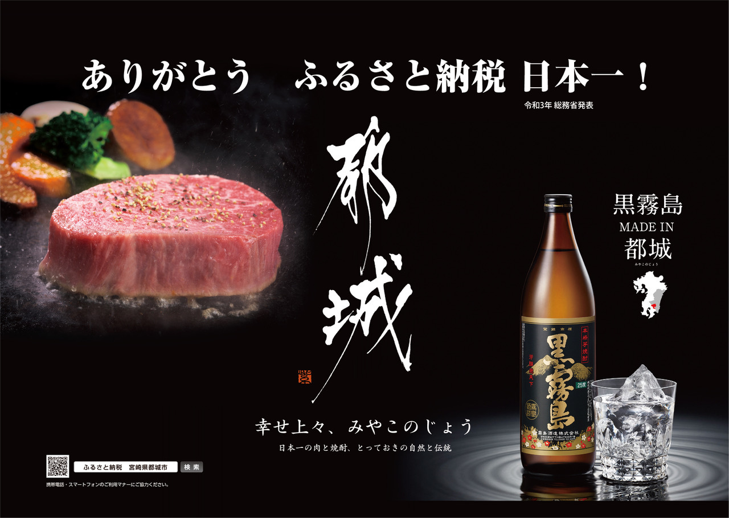

Slide 7
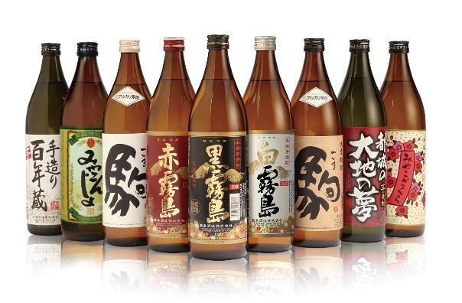
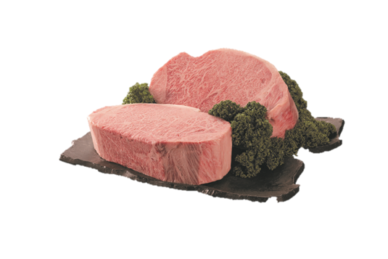
◆Hometown Tax?◆
A tax yield reduction tax donation system established in order to correct the disparity between rural areas and large cities as well as issues caused by population decline.
◆Contributor Merits◆
・Choice over municipality
・Allocation discretion of your funds
・Receiving specialty or thank you goods
・Tax reductions or refunds
◆Municipality Merits◆
・Increased earnings
・Beneficial for PR

Slide 8

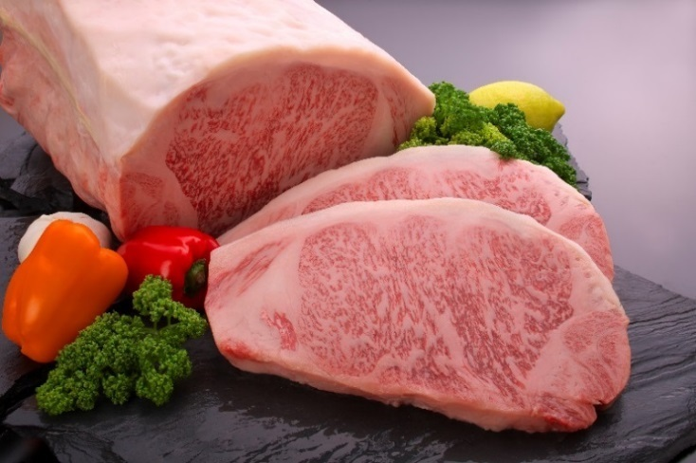
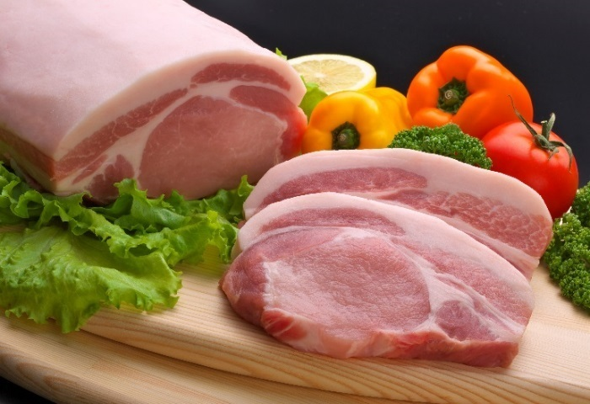
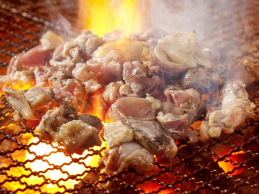
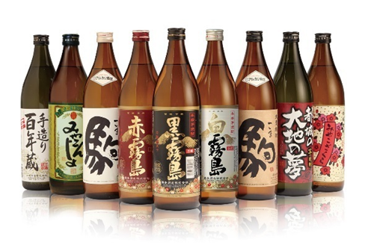
◇Beef, Pork, and Poultry Production Value: Number 1 in Japan!
◇Wagyu Beef Proficiency Prize Show（Wagyu Olympics）
Miyazaki Beef: Four Consecutive Victories!!
（Prime Minister’s Cabinet Prize Award Winner）
◇Shochu Sales: #1 in Japan!
(11 Consecutive Years of Kirishima Brewing)

Slide 9

With Japan’s Best Meat and Shochu:
“Meet”ing Meat Tour
Meat Tourism

Slide 10
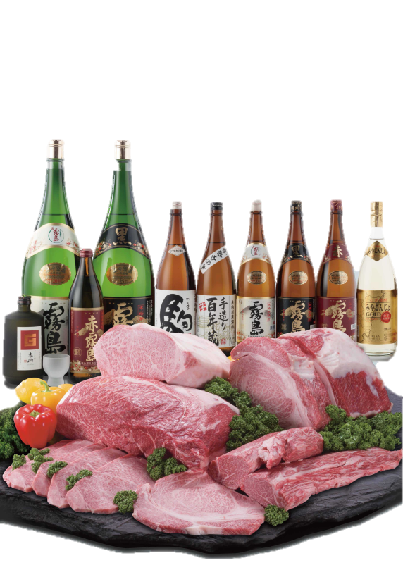
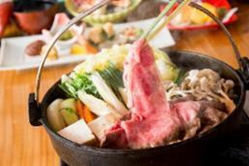

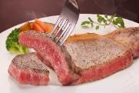
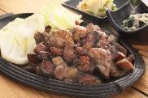
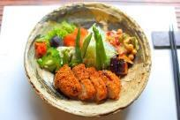
Tour Development Support Grant System
● Subsidy Requirements (Maximum subsidy amount of 500,000 yen per tour)
① Tour participants reach 5 or more people
② Eat from a city selected menu
③ Stay at a lodging facility within the city
● Subsidy Amount
＋
Subsidy Per Person
10,000Yen
Grand Menu
12,100 Yen～
Lodging
＋
Subsidy Per Person
3,000Yen
City Selected Menu 3,300 Yen～
Lodging

Slide 11

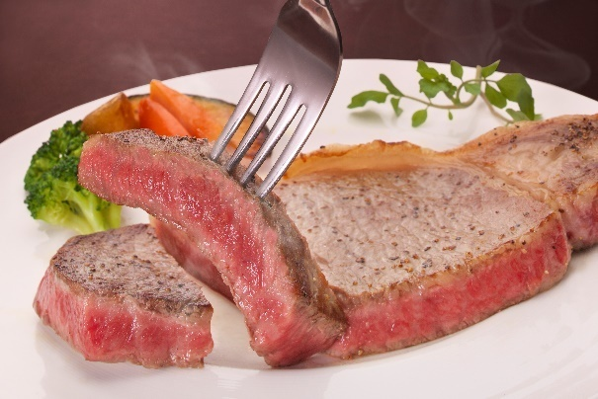
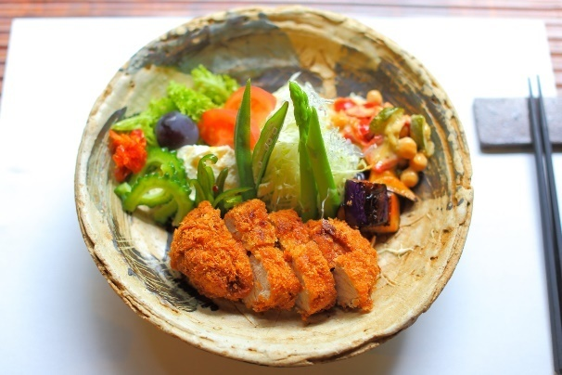

「A Trip to Taste Genuine Meat and Shochu」
● Grand Menu
High Quality
Made in Miyakonojo Miyazaki Beef
（Normal Price: 12,100 Yen）
● Popular Local～
Beef, Pork, and Poultry Cuisine NormalPrice: 3,300 Yen

Slide 12

Individual Meat Touring Service（Meat Ticket）
● Use Conditions
① Miyakonojo City residents over 20 years old
② Use with 2 or more people
③ Stay at a lodging facility within the city
● Meat Ticket
Per person:
3,000 Yen
（Electronic Coupon）
＋
Lodging
City Selected Restaurants

Slide 13
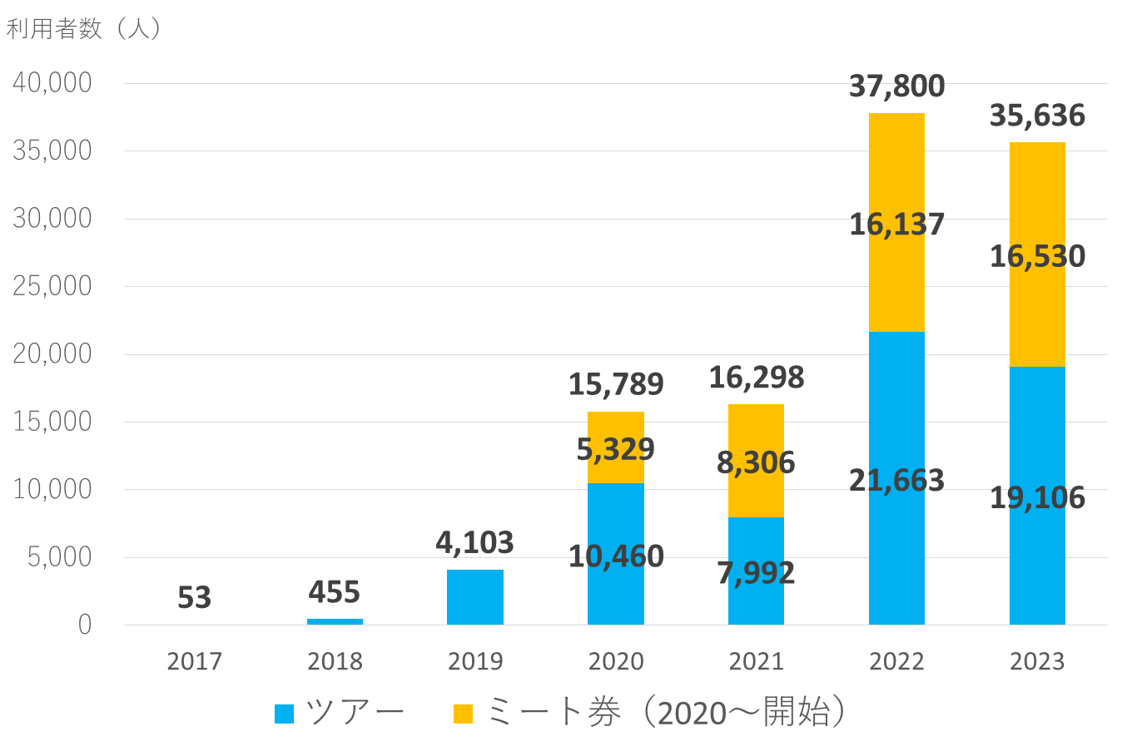
～Customers Utilizing Meat Series: Development～
Number of Customers （people）
Tourism
Meat Ticket （starting in 2020 ）

Slide 14


Please visit Miyakonojo!

