Slide 1
Introduction of WeGO
Kakim Danabayev, Senior Program Officer

Slide 2
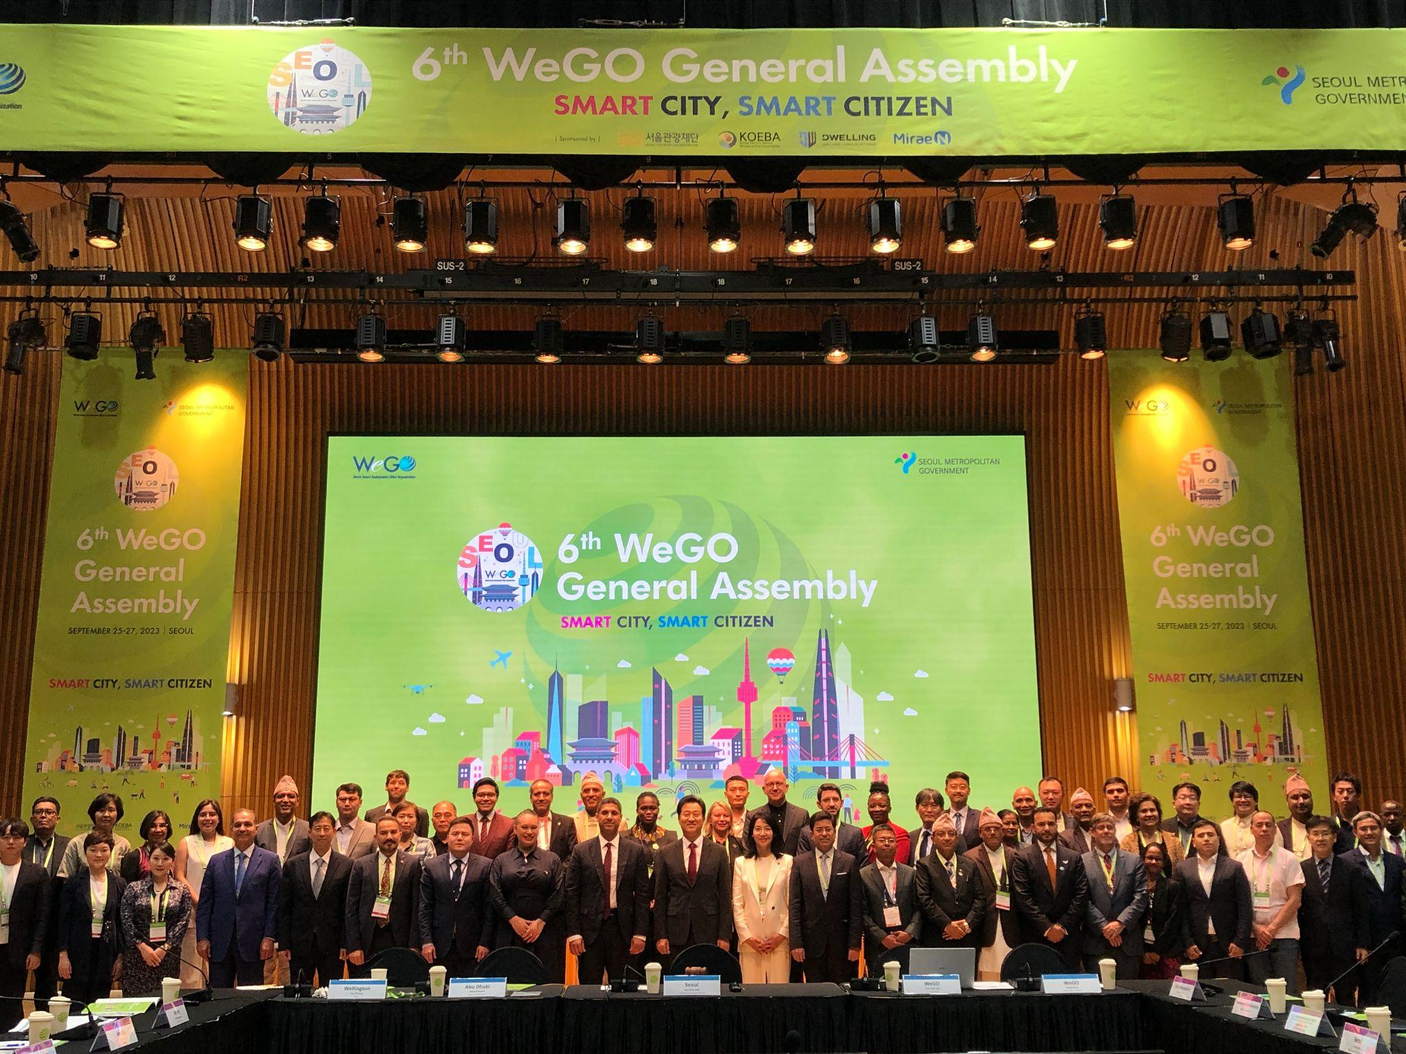
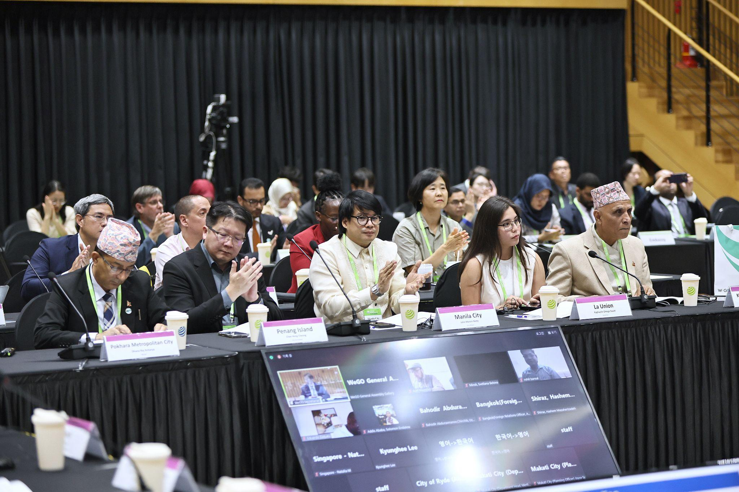
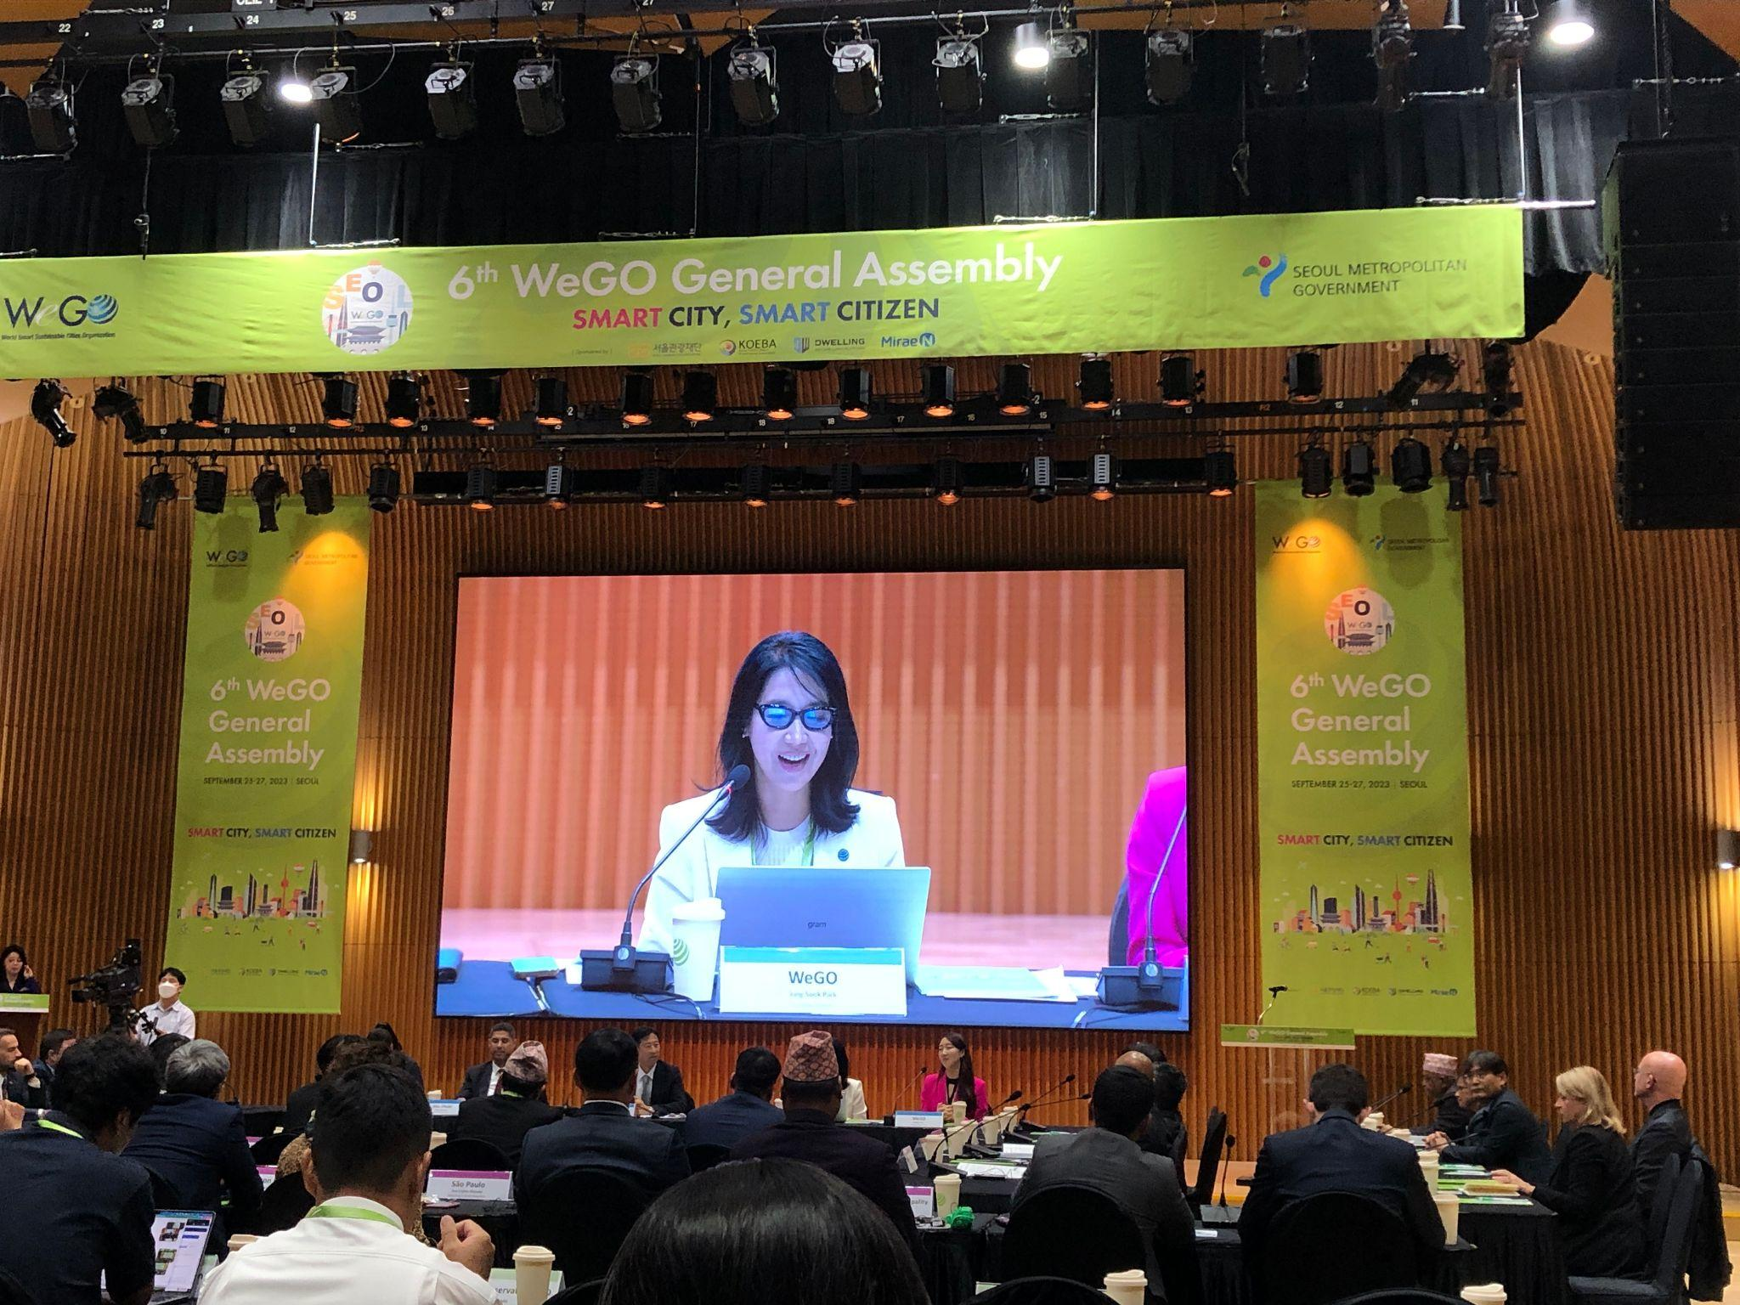
01 |
About WeGO
Overview
The World Smart Sustainable Cities Organization (WeGO), established by 50 founding members in 2010, is an international association of city and local governments, smart tech solution providers, and national and regional institutions committed to the transformation of cities into smart sustainable cities through facilitating public-private partnership (PPP).
WeGO has more than 200 members around the world and serves as their international platform to improve the quality of life, innovate in the delivery of public services, and strengthen regional competitiveness.

Slide 3
01 |
About WeGO
WeGO’s Network
202
Members
164
Local
Governments
20
Corporations
18
Institutions
=
+
+

Slide 4
01 |
About WeGO
WeGO’s Network
AFRICA | 27
Cameroon
Ethiopia
Ghana
Kenya
Mozambique
Nigeria
Rwanda
Senegal
South Africa
Tanzania
Uganda
Zambia
Zimbabwe
EUROPE | 16
Belarus
Belgium
France
Germany
Netherlands
Romania
Russia
Turkey
MIDDLE EAST & NORTH AFRICA | 29
Iran
Iraq
Morocco
Oman
Palestine
Sudan
Tunisia
United Arab Emirates
Andek, Batibo, Tubah
Addis Ababa
Accra
Nairobi
Maputo
Abuja, Calabar, Donga, Jalingo, Kaduna State, Sokoto State, Takum
Kigali
Dakar
Tshwane
Dar es Salaam
Kampala
Kasama, Lunte
Harare
Minsk
Brussels
Paris
Berlin, Frankfurt
Rotterdam
Bucharest
Magas, Moscow, Vladivostok
Ankara, Antakya, Beyoğlu, Gaziantep, Malatya, Muğla
Isfahan, Shiraz, Tabriz
Erbil
Rabat
Muscat
Hebron, Ramallah
Khartoum Locality
La Marsa, Menzel Jemil, Tunis
Abu Dhabi

Slide 5
01 |
About WeGO
WeGO’s Network
ASIA-PACIFIC | 77
Australia
Azerbaijan
Bangladesh
China
Fiji
India
Indonesia
Japan
Kazakhstan
Kyrgyzstan
Korea
Malaysia
Mongolia
Nepal
New Zealand
Pakistan
Philippines
Sri Lanka
Thailand
Uzbekistan
Vietnam
Ryde
Baku
Dhaka North, Dhaka South, Rajshahi
Chengdu, Dujiangyan, Hong Kong SAR, Ningbo, Zhejiang Province
Suva
Agra
Bandung, Batam, Bau-Bau, Jakarta, Riau Islands, Serang Regency
Saga Prefecture
Almaty, Astana
Bishkek
Anyang, Gimpo, Goyang, Jeju, Sejong, Seongnam, Seoul
Penang Island, Seberang Perai
Altai, Choibalsan, Erdenet, Sainshand, Ulaanbaatar
Belbari, Bhadrapur, Bharatpur, Birgunj, Dharan, Dhulikhel, Itahari, Kathmandu, Kankai, Patharishanishchare, Pokhara, Ramgram, Ratuwamai, Shivasatakshi, Sunawarshi, Sundarharaicha, Sunwal, Tarakeshwor
Wellington
Islamabad, Peshawar
Baguio, Cauayan, La Union, Makati, Manila, Quezon City, San Fernando La Union
Dambulla, Galle, Matale, Sri Jayawardenapura Kotte
Bangkok
Tashkent, Chirchik
Da Nang, Ha Noi, Thua Thien Hue
AMERICAS | 15
Argentina
Brazil
Costa Rica
Dominican Republic
Ecuador
Mexico
Paraguay
Peru
United States
Venezuela
San Antonio de Areco
Porto Alegre, São Paulo
Buenos Aires
Villa Tapia
Cuenca
Coatzacoalcos, Mexico City
Asunción
Lima, Cusco, Urubamba
Pittsburgh, San Francisco
Caracas

Slide 6
01 |
About WeGO
WeGO’s Network

Slide 7
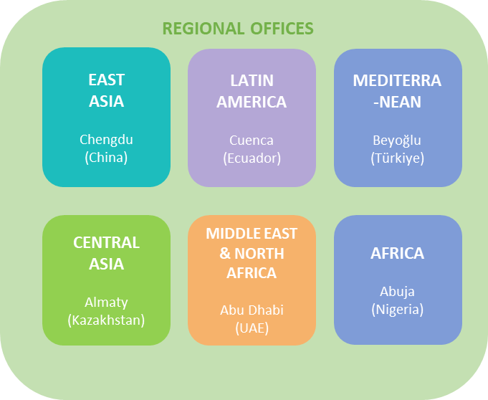
01 |
About WeGO
Governance
PRESIDENT CITY
Seoul (South Korea)
WeGO SECRETARIAT
Seoul (Korea)
EXECUTIVE VICE PRESIDENT CITY
Almaty (Kazakhstan)
VICE PRESIDENT CITIES
Kampala (Uganda)
São Paulo (Brazil)
EXECUTIVE COMMITTEE MEMBER CITIES
Abu Dhabi (United Arab Emirates), Abuja (Nigeria), Almaty (Kazakhstan), Chengdu (China), Cuenca (Ecuador), Hebron (Palestine), Makati (The Philippines), Kampala (Uganda), Maputo (Mozambique), Ramgram (Nepal), São Paulo (Brazil), Seberang Perai (Malaysia), Seoul (Korea), Wellington (New Zealand)

Slide 8
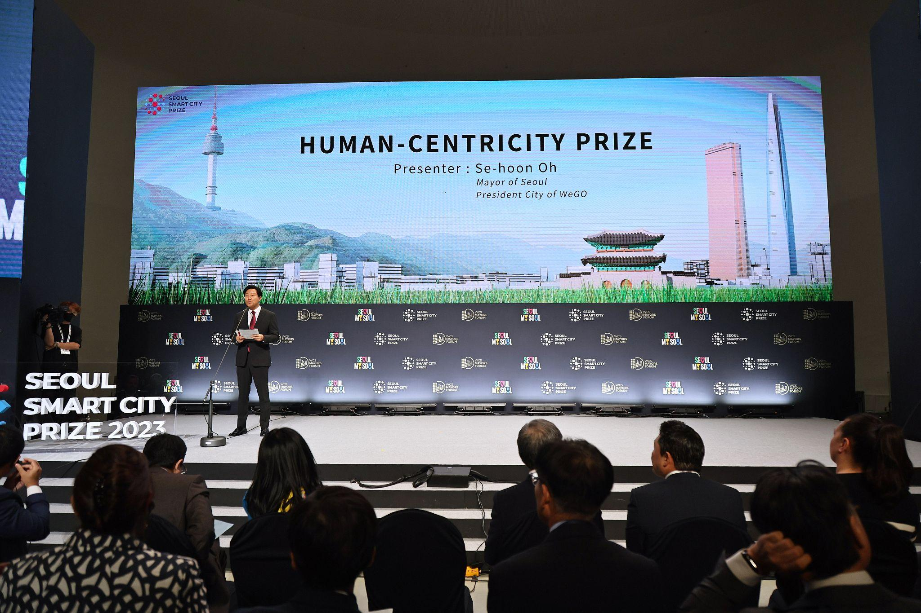
02 |
WeGO’s Priority 2024
Human-Centered Smart Cities
Human-Centered Smart Cities
To build Human-Centered smart cities, inclusion has become one of the most important values in today’s smart city development.
Technology, despite causing the digital divide, can still be the driving force in reducing the gap and ensuring an inclusive digitalization of public services that benefit all people in sectors ranging from mobility, safety, welfare, environment, culture, and governance.

Slide 9
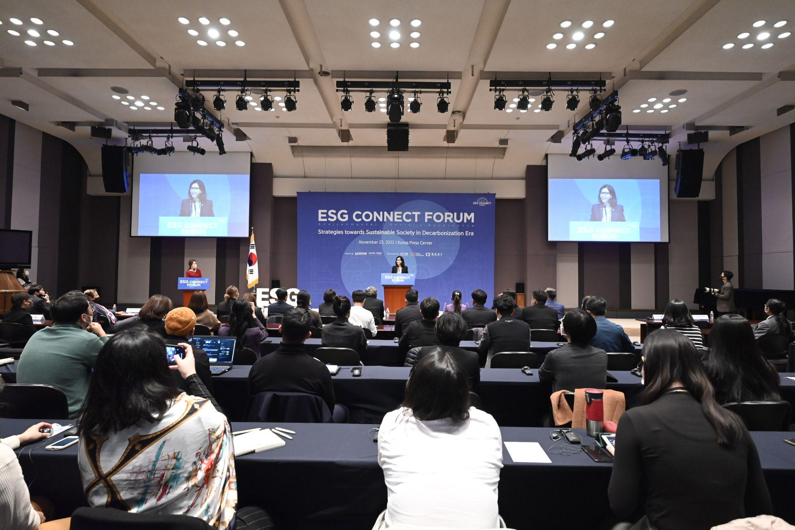
02 |
WeGO’s Priority 2024
ESG framework into Smart Sustainable Cities Development
Environment, Social, Governance
Incorporating the dimensions of ESG, WeGO aims to promote ESG issues starting from business practices to socially profitable values that combine ICT with greater social inclusion and greater access to services of a city to meet the needs of governments, citizens, and businesses, prioritizing Environmental, Social, and Governance (ESG) criteria as a “socially responsible city.”

Slide 10
02 |
WeGO’s Priority 2024
Increase Partnerships for more Innovative Financing and Tech Solutions
Increase Partnerships for more Innovative Financing and Tech Solutions
In line with WeGO’s vision of “exploiting the power of digital technologies” and “accessing investment for smart sustainable cities development”, WeGO will actively partner with tech and ﬁnance solution providers to provide more and improved programs and services to its members.
WeGO will continue striving to engage with more public and private actors to expand on the Public-Private Partnership (PPP) model.

Slide 11
02 |
WeGO’s Priority 2024
Digital Ethics
Digital Ethics
Emphasis on the significance of digital ethics in integration, delivering comprehensive services, and adhering to appropriate protocols.
Fraudulent transactions, dissemination of fake news, sexual offenses, financial scams, and the like often be traced back to fabricated online identities.
The pursuit of equitable digitalization is not just a technological imperative but a moral and strategic imperative for creating sustainable and fair urban futures.

Slide 12
02 |
WeGO’s Priority 2024
Decentralization and Regional Approach
Decentralization and Regional Approach
The pandemic has highlighted the importance of cities and local governments as Smart City transformation drivers.
Recognizing the constraints in the national level approach, the role of cities and local governments as transformation drivers to stimulate city-specific development and activate citizen participation is paramount.

Slide 13
02 |
WeGO’s Priority 2024
CitiVerse & Smart Life for Smart City
Smart Life in Smart City
“Smart Life in Smart City” describes WeGO’s aim to exemplify our strategy around digital technologies, and their evolution in the advent of emerging virtual worlds such as artificial intelligence (AI), digital twin, and metaverse solutions that are implemented in the welfare, tourism, public safety, and civil services around the world.

Slide 14
WeGO Activities

Slide 15
03 |
About WeGO
WeGO Activities 2024
Project Implementation
& Matchmaking
Capacity-building
Research & Development
Knowledge-sharing
& Networking
Regional Activities
Governance Activities

Slide 16
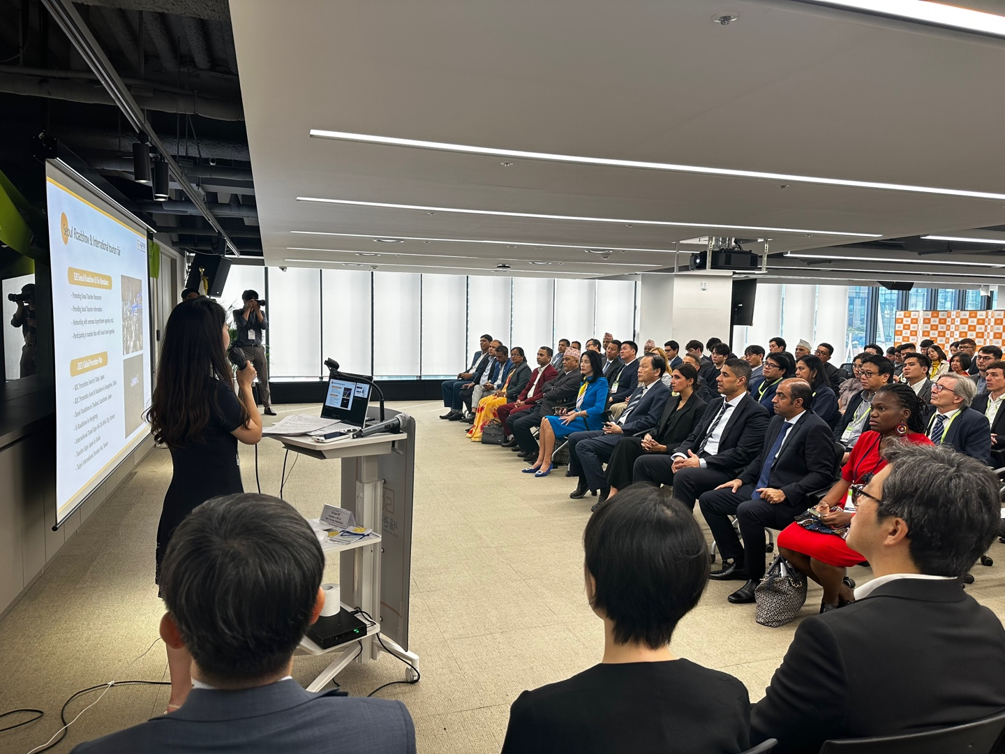
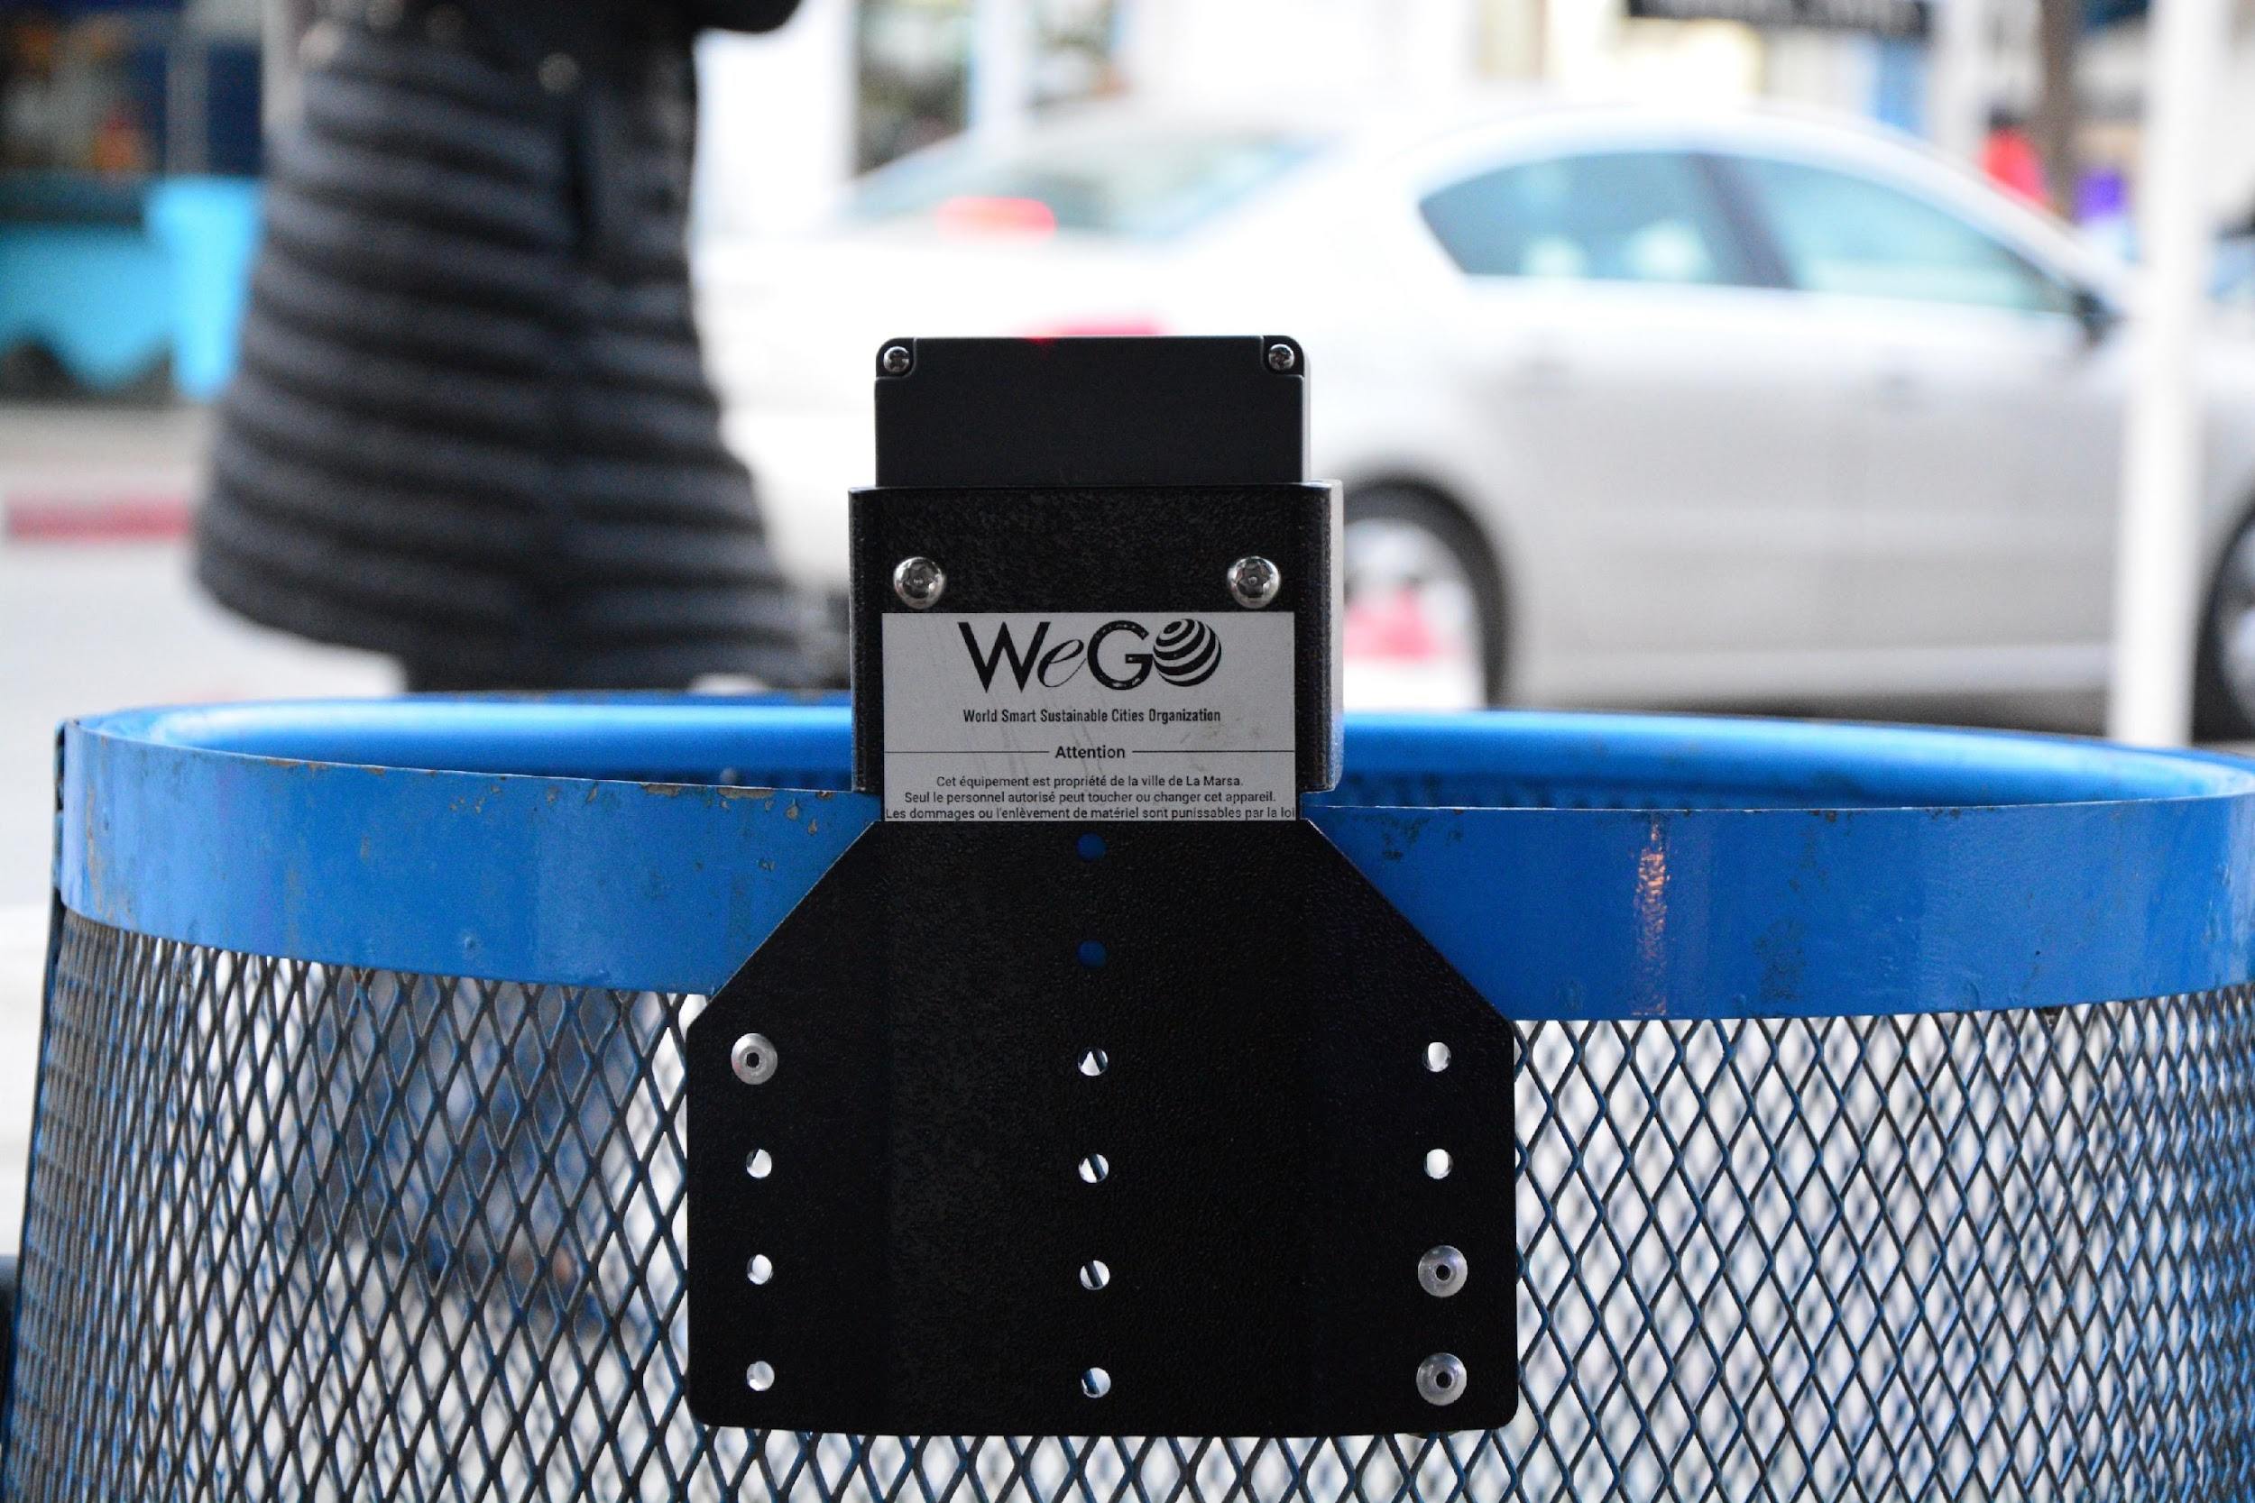
03 |
About WeGO
WeGO Activities 2024 - Project Implementation & Matchmaking
WeGO holds the key to the solutions by providing its network of corporate members and partners that can improve public services in ways that meet the needs of today’s tech-savvy society. WeGO provide assistance to its members to solve urban problems through introducing smart solutions and collaborative opportunities.
Solution Meet Cities
Share your current city challenges with WeGO and have a matchmaking session with solution providers from WeGO network.
Discuss and share your smart city plans with the WeGO network.
Feasibility Studies and Project Implementation
Share your project proposal with WeGO and establish direct project partnerships within the WeGO network.
Become a beneficiary city of WeGO Smart Sustainable City Feasibility Study Program.

Slide 17
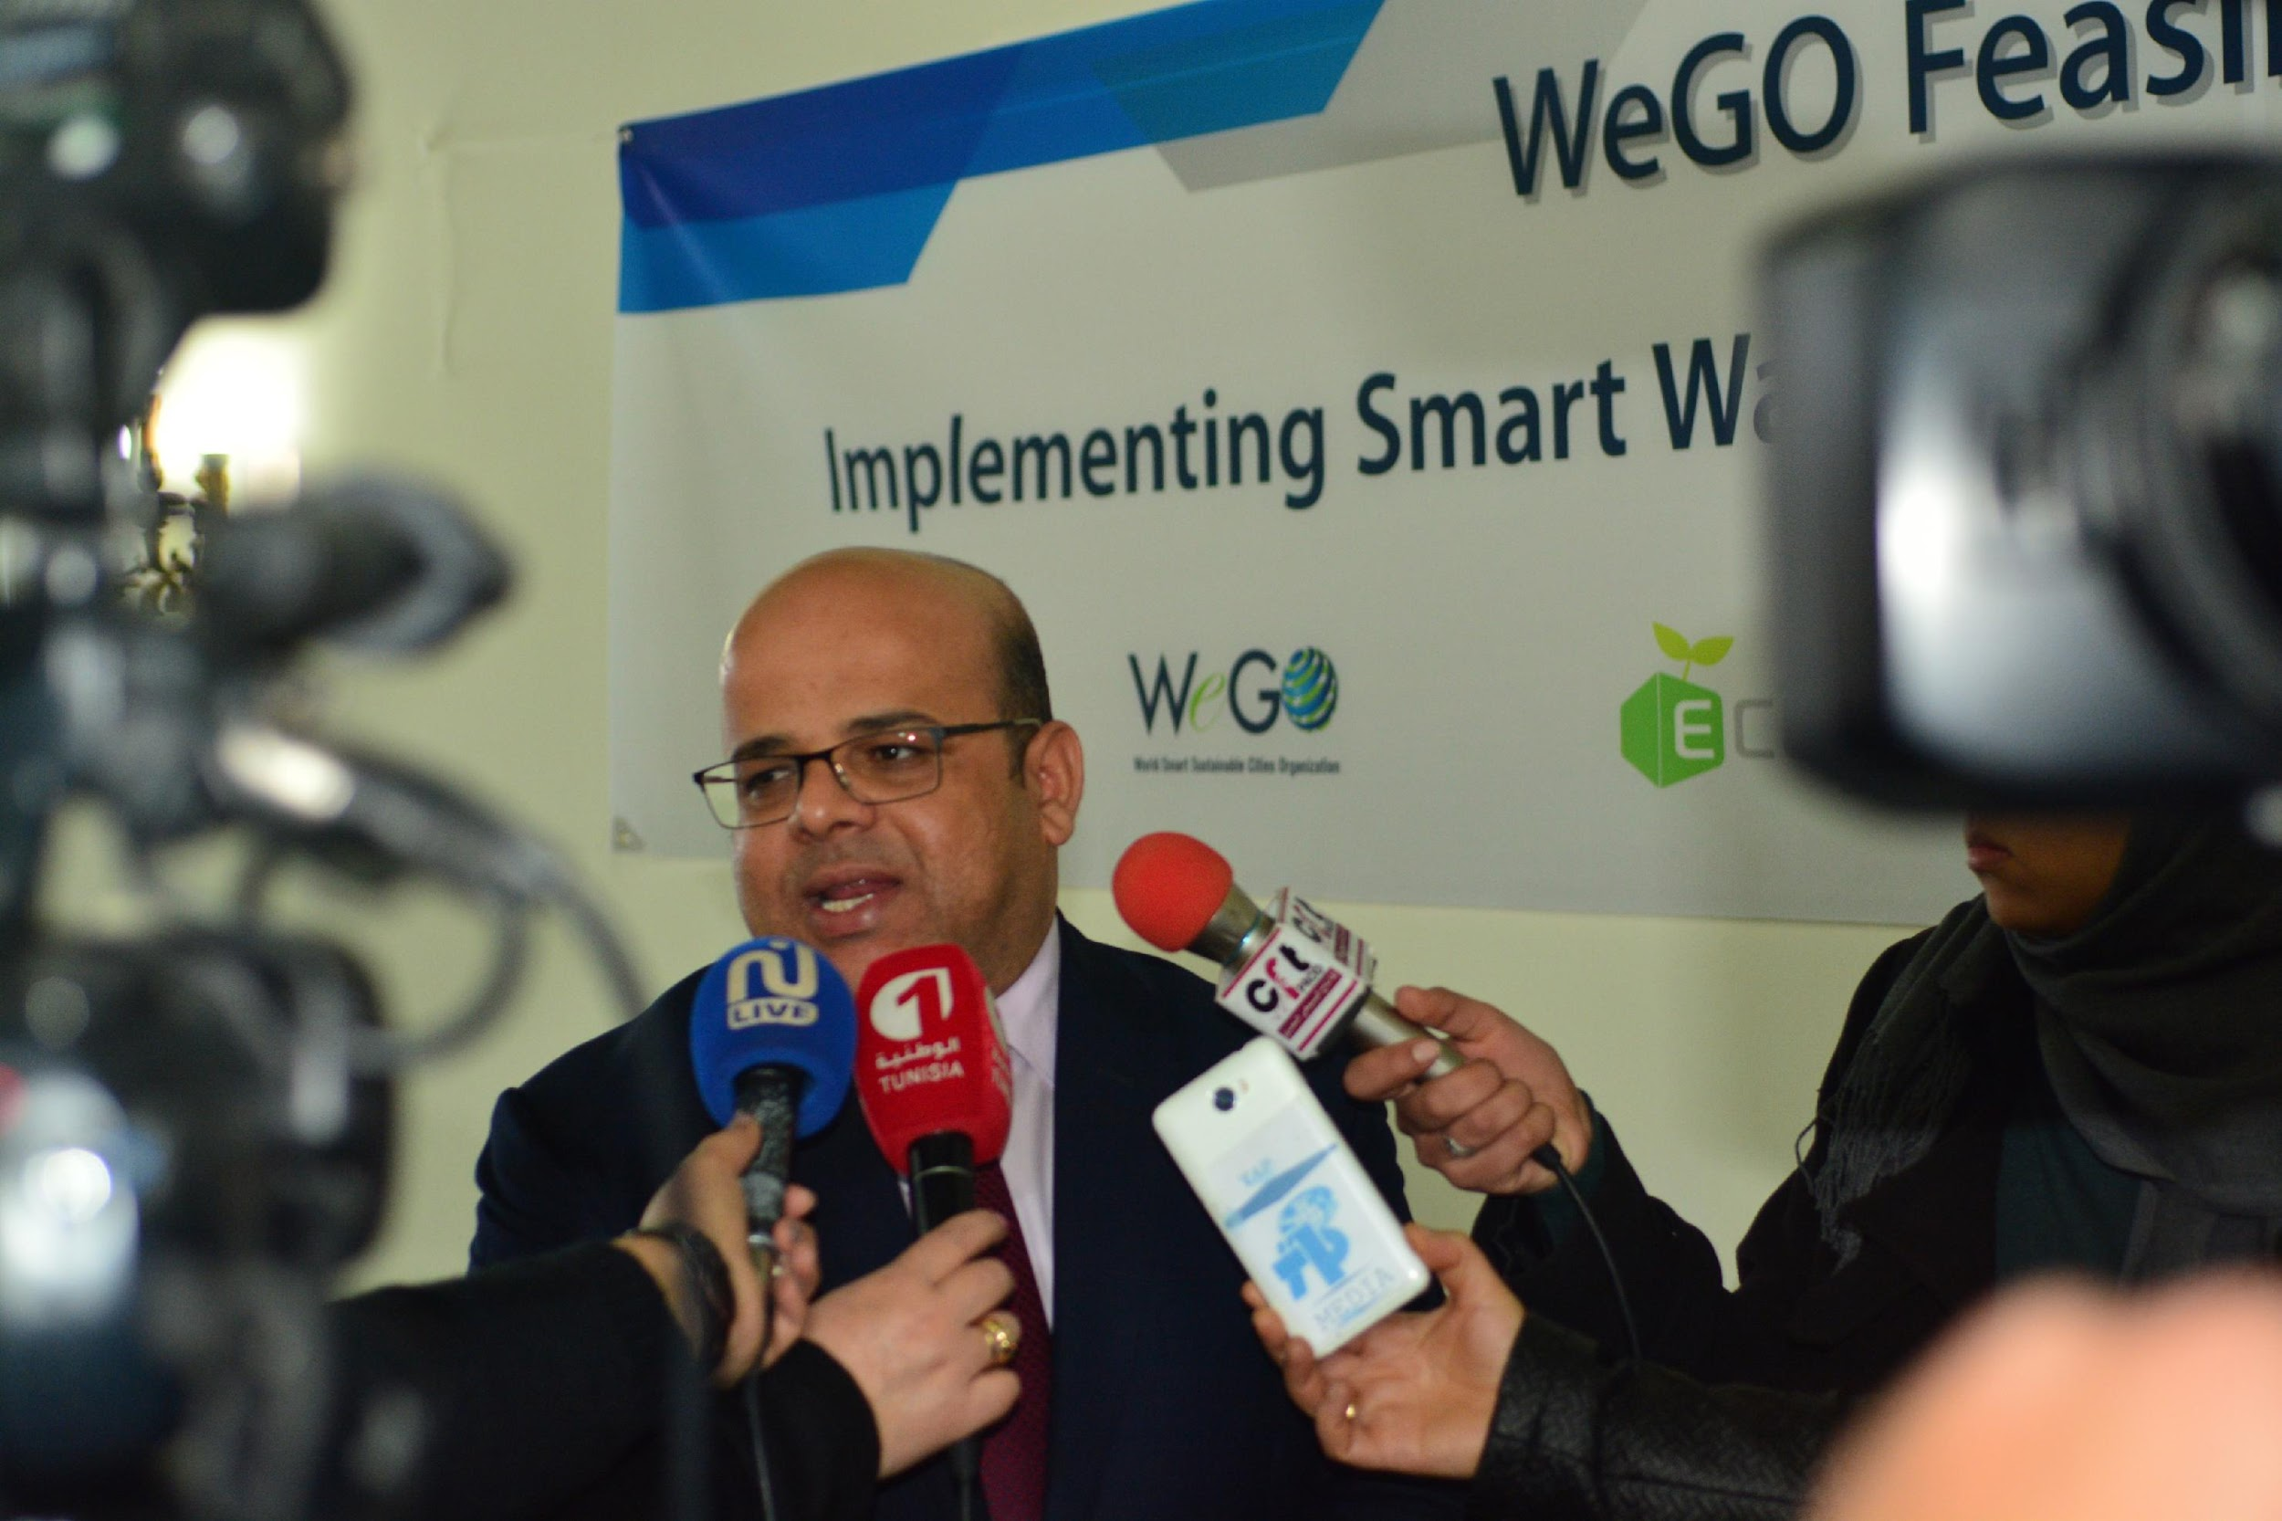
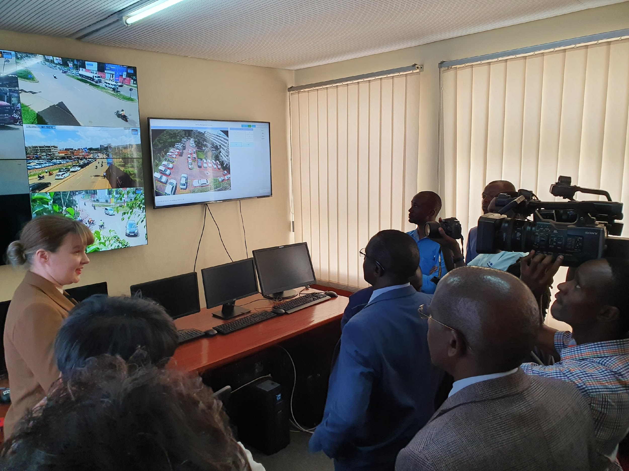
03 |
About WeGO
WeGO Activities 2024 - Project Implementation & Matchmaking
2024 Seoul Smart City International Cooperation Program
This initiative, conducted in partnership with the Seoul Urban Solutions Agency (SUSA) and accessible to finalists of the Prize, presents a distinctive opportunity to execute a smart city project, and encompasses support for conducting pre-feasibility studies.
Purpose
The program seeks to identify smart city projects addressing urban problems by local governments of partner cities. Through this initiative, the Seoul Metropolitan Government aims to foster collaboration between Seoul and partner cities, thereby contributing to the successful implementation of these projects.
Amount per project
Up to KRW 200 million (approximately, US$ 150,000)

Slide 18
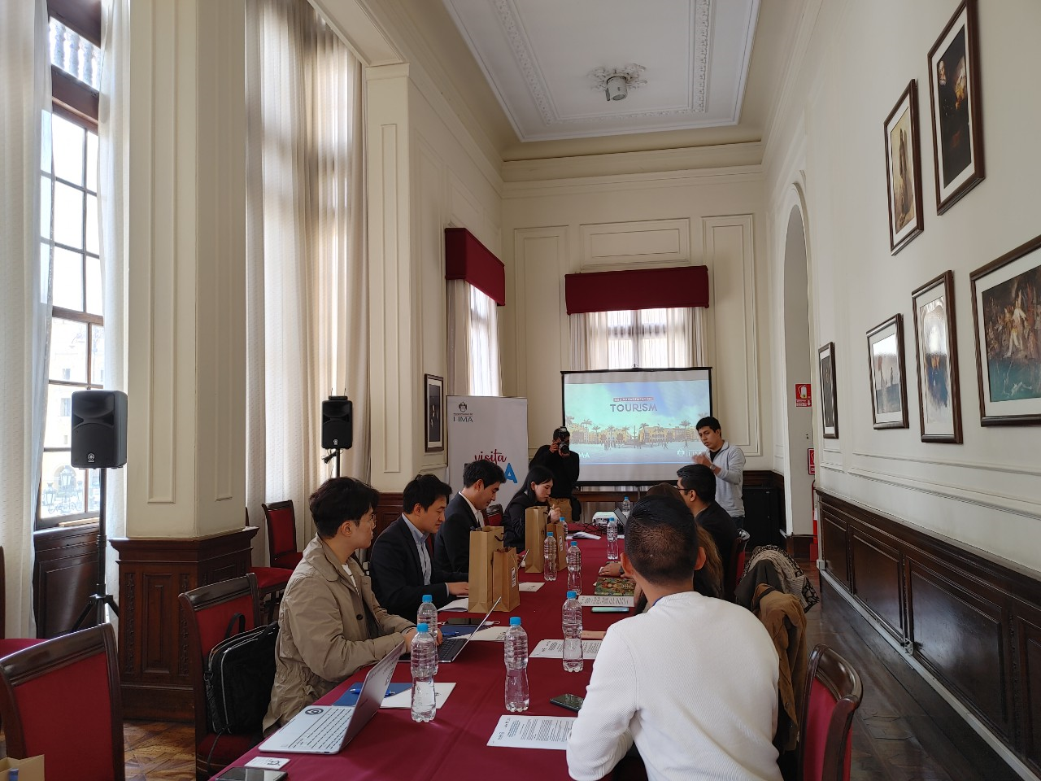
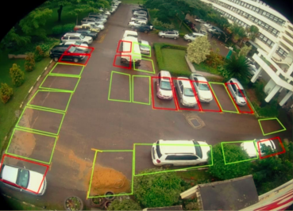
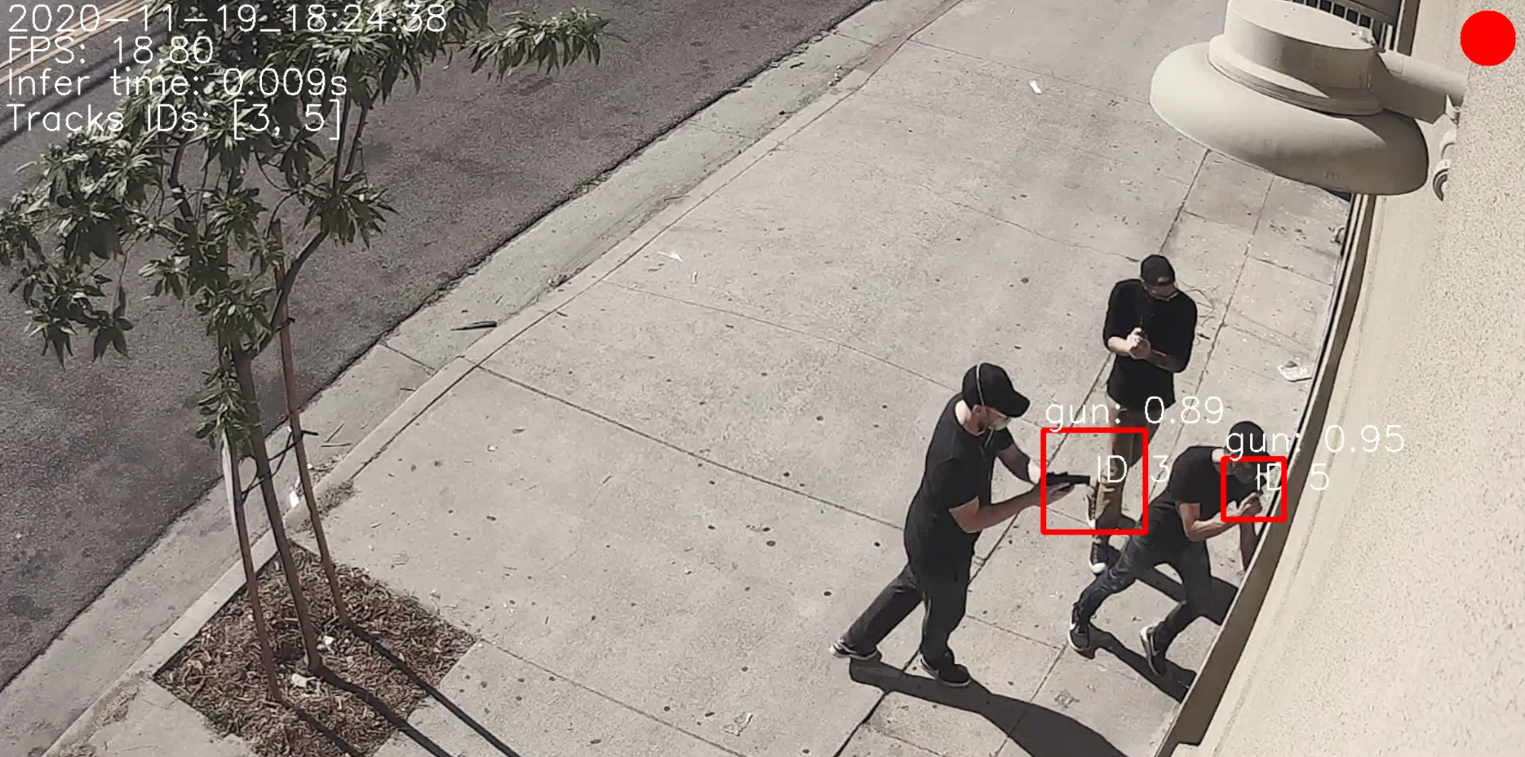
03 |
About WeGO
WeGO Activities 2024 - Project Implementation & Matchmaking
Year-round
PROJECT IMPLEMENTATION - Feasibility Studies and Project Implementation
Some of the latest Feasibility Studies carried by WeGO include:
2023 - Baguio, Philippines - GIS Map-based AI Heterogeneous Data Convergence City Management System
2022- Lima, Peru - WeGO-NIA Feasibility Study for “Lima Smart Tourist Destination”
2019- Kampala, Uganda - The Unified Smart Parking Platform
2018- Da Nang, Vietnam - Data Analytics for Smart Traffic
2017- La Marsa, Tunisia - Smart Waste Management System
2016- Seberang Perai, Malaysia - Smart Street Lamp & Traffic Light Monitoring System

Slide 19
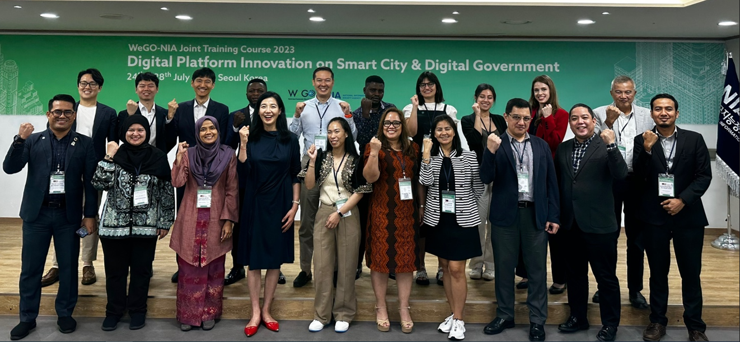
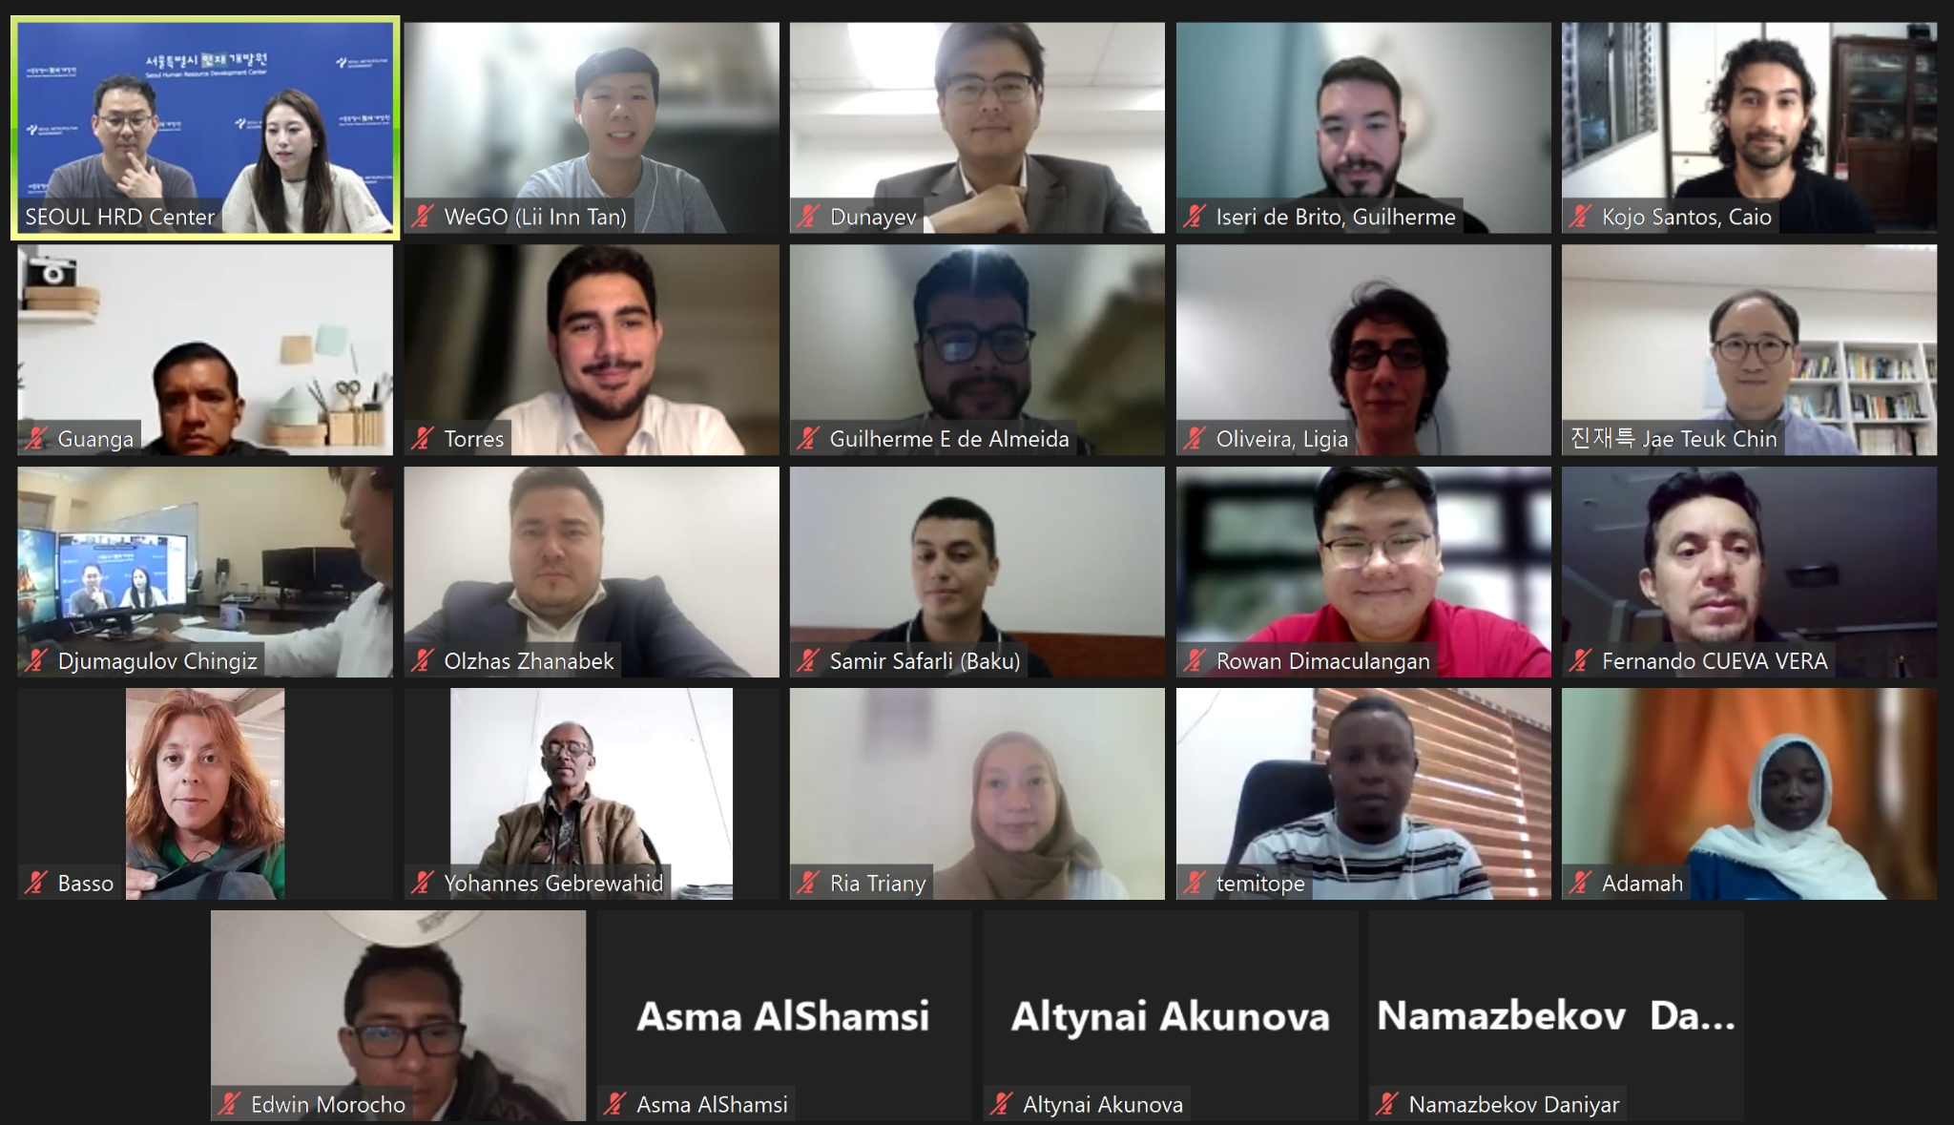
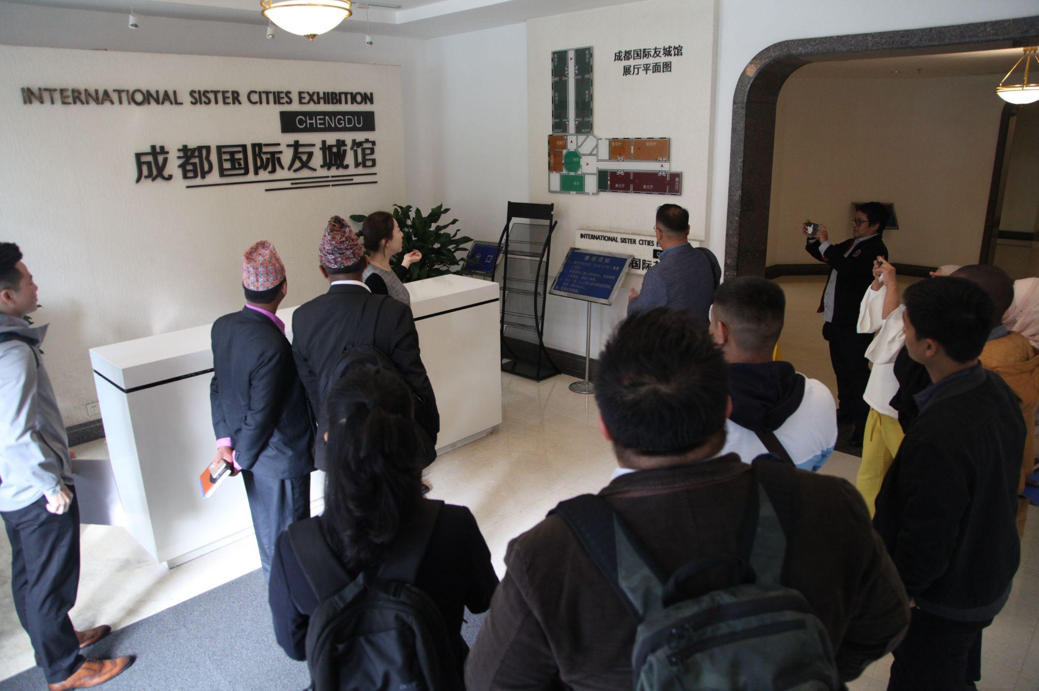
03 |
About WeGO
WeGO Activities 2024 - Capacity Building
WeGO-NIA Joint Workshop
Seoul, Korea l Q3
Annual workshop to provide capacity building for government officials working in the fields of ICT and other smart city related areas.
WeGO Smart Sustainable Cities Training Program
Online & Offline Seoul, Korea l Q4
Finalists from the Seoul Smart City Prize will get the opportunity to receive a 4-week online and offline training program through a series of virtual live lectures and smart city tours in Seoul.
WeGO East Asia Regional Office Smart City Training Program
Chengdu, China l Q4
Organized since 2014, the training incorporates lectures and technical tours on smart city initiatives successfully adopted throughout Chengdu. An offline program in Chengdu will be planned if the pandemic situation is getting better. Otherwise, an online program most likely will take place.

Slide 20
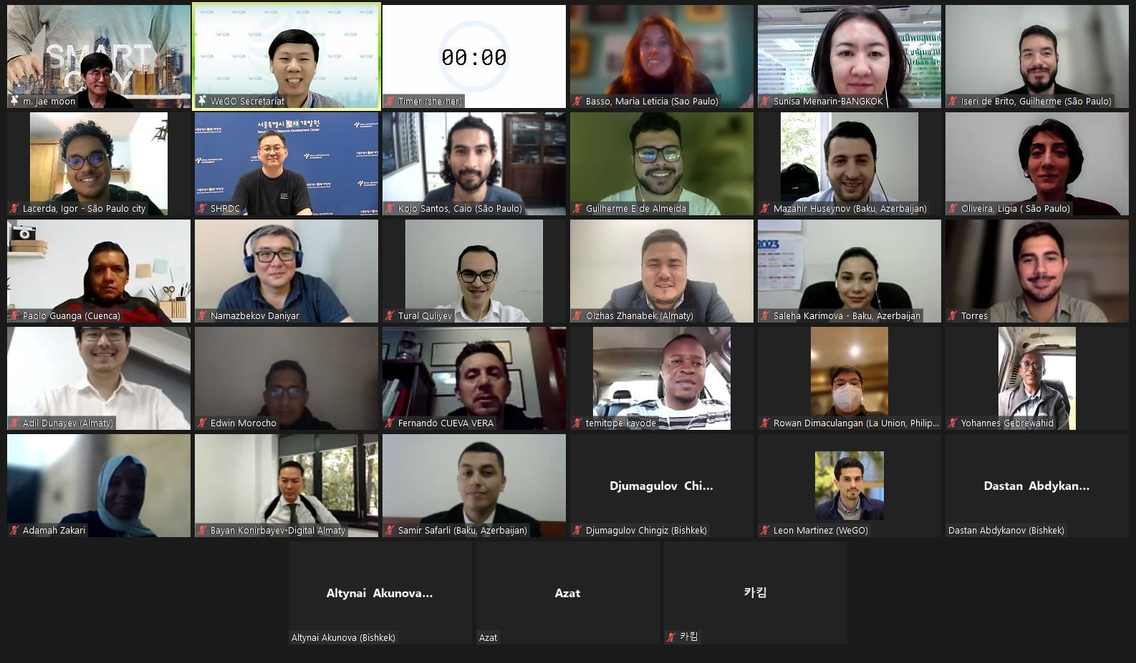
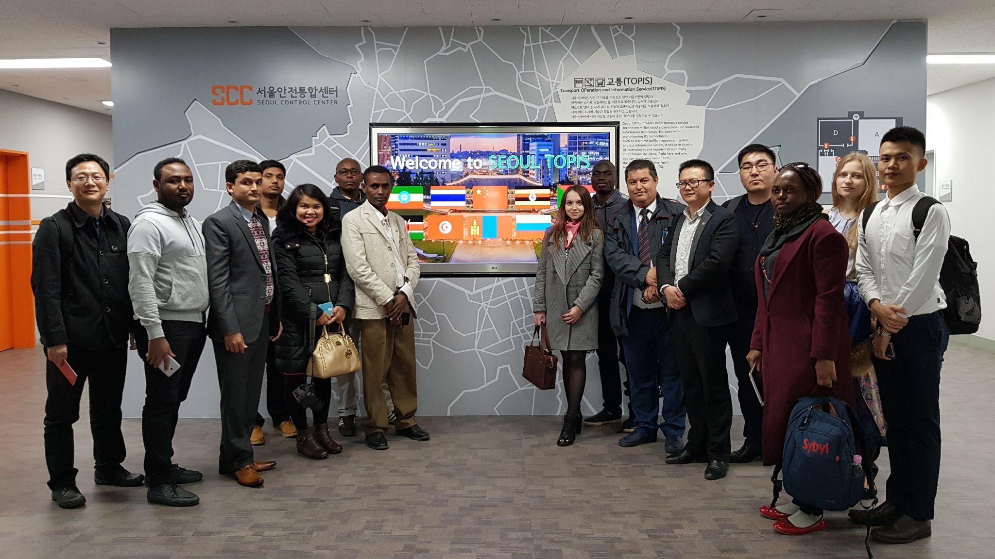
03 |
About WeGO
WeGO Activities 2024 - Capacity Building
Seoul Smart City Prize Winners Training Program
Winners of the Seoul Smart City Prize will have the chance to partake in a four-week training program, which will be conducted both online and offline. The program will include a variety of virtual live lectures and tours of smart city initiatives in Seoul.
ONLINE
2024.06.19 - 2024.07.09 (3 Weeks)
e-Learning | live virtual lectures | discussion
OFFLINE
2024.10.07 - 2024.10.11 (1 Week)
case study | smart city tour | smart life week

Slide 21
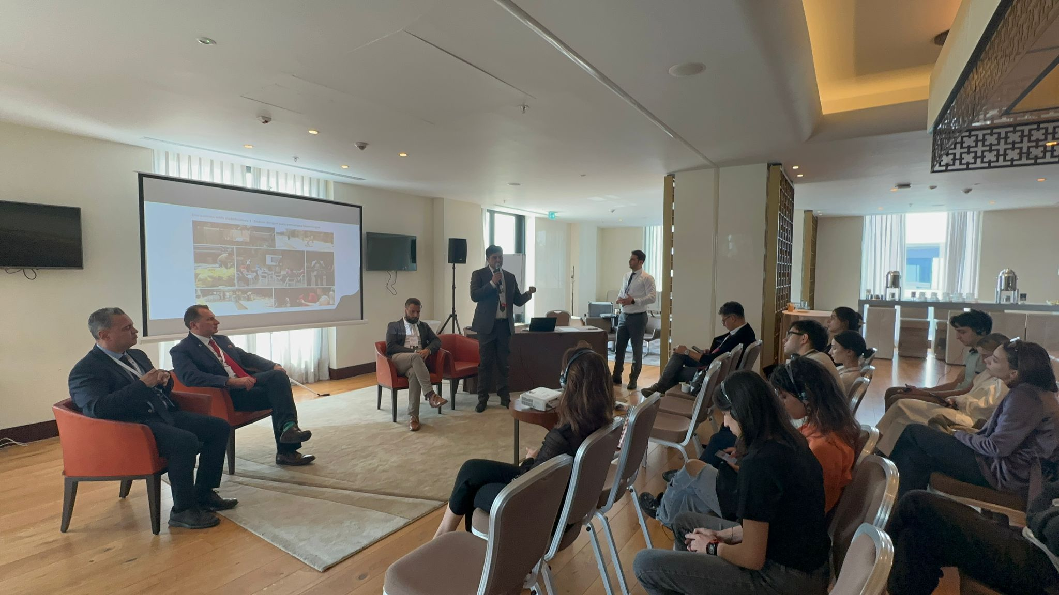
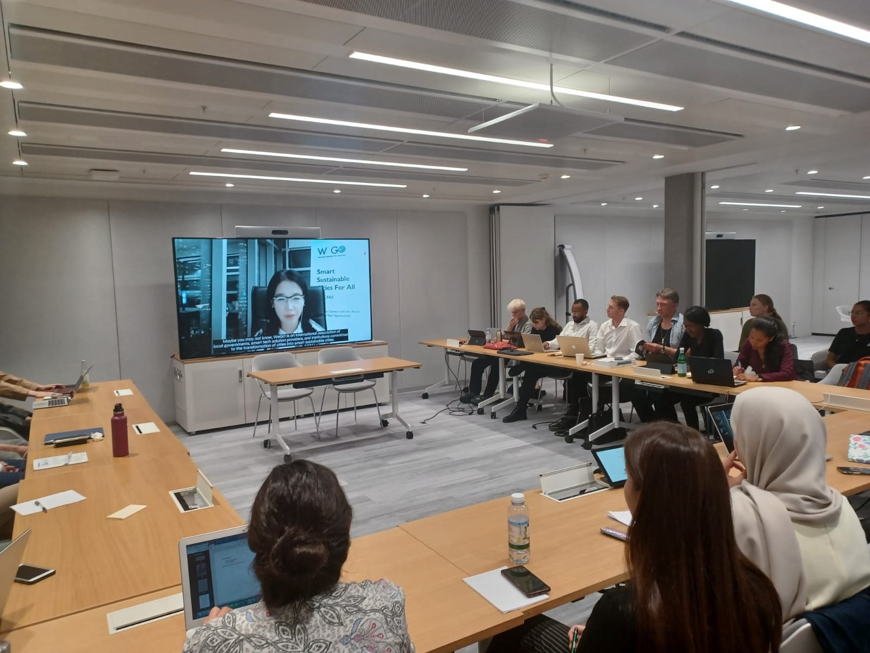
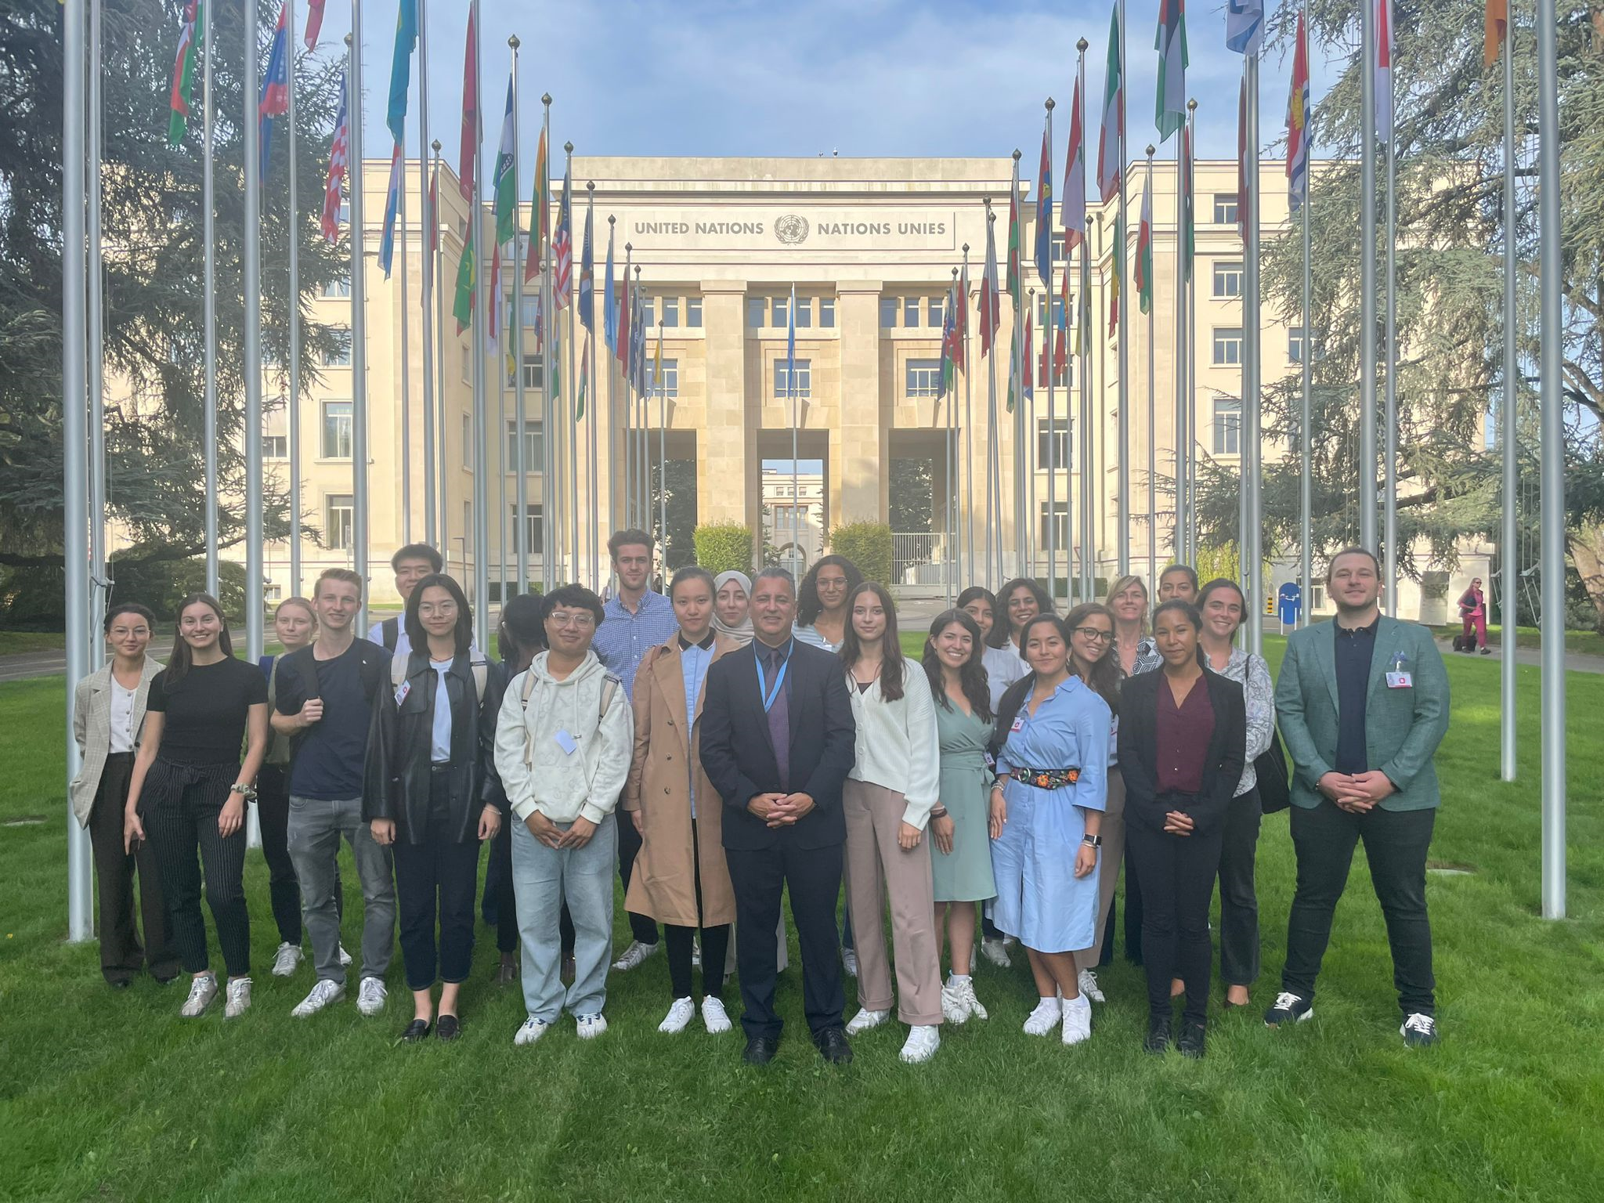
03 |
About WeGO
WeGO Activities 2024 - Capacity Building
TRAINING PROGRAMS- WeGO Sustainable Smart City Champions
In 2023, WeGO has expanded the geographical scope of the program by making the learning from the program into a hybrid format.
An online course with eight (8) lectures is available for all students interested via www.cityresiliencetraining.com. It is accessible and free, and a certificate will be issued upon completion. More lectures will be added this 2024.
The in-person sessions, on the other hand, were held in six cities around the world: Baku (Azerbaijan), Munich (Germany), Geneva (Switzerland), Athens (Greece), Milan (Italy), and Los Angeles (USA). More cities are going to be included this 2024.

Slide 22
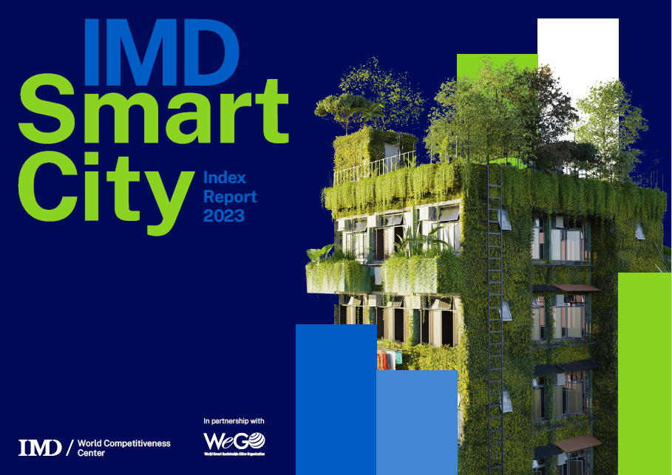
03 |
About WeGO
WeGO Activities 2024 - Research & Development
R&D Smart City Index Research
WeGO, in partnership with IMD, recognized cities’ efforts in human-centered smart city development through the Smart City Index Report 2023. The IMD Smart City Index is distinctive because it utilizes city level data from the Human Development Index.
This comprehensive approach considers various indicators, such as life expectancy, education, and income, offering a more holistic view of the quality of life for city residents, as opposed to country-level data
Using the measurements to capture human-centered smart city development, WeGO and IMD have been working together to publish a case study book, showcasing the select winners from the Seoul Smart City Prize 2023. WeGO will explore the Smart City Index for 2024.
WeGO will explore the Smart City Index for 2024.

Slide 23
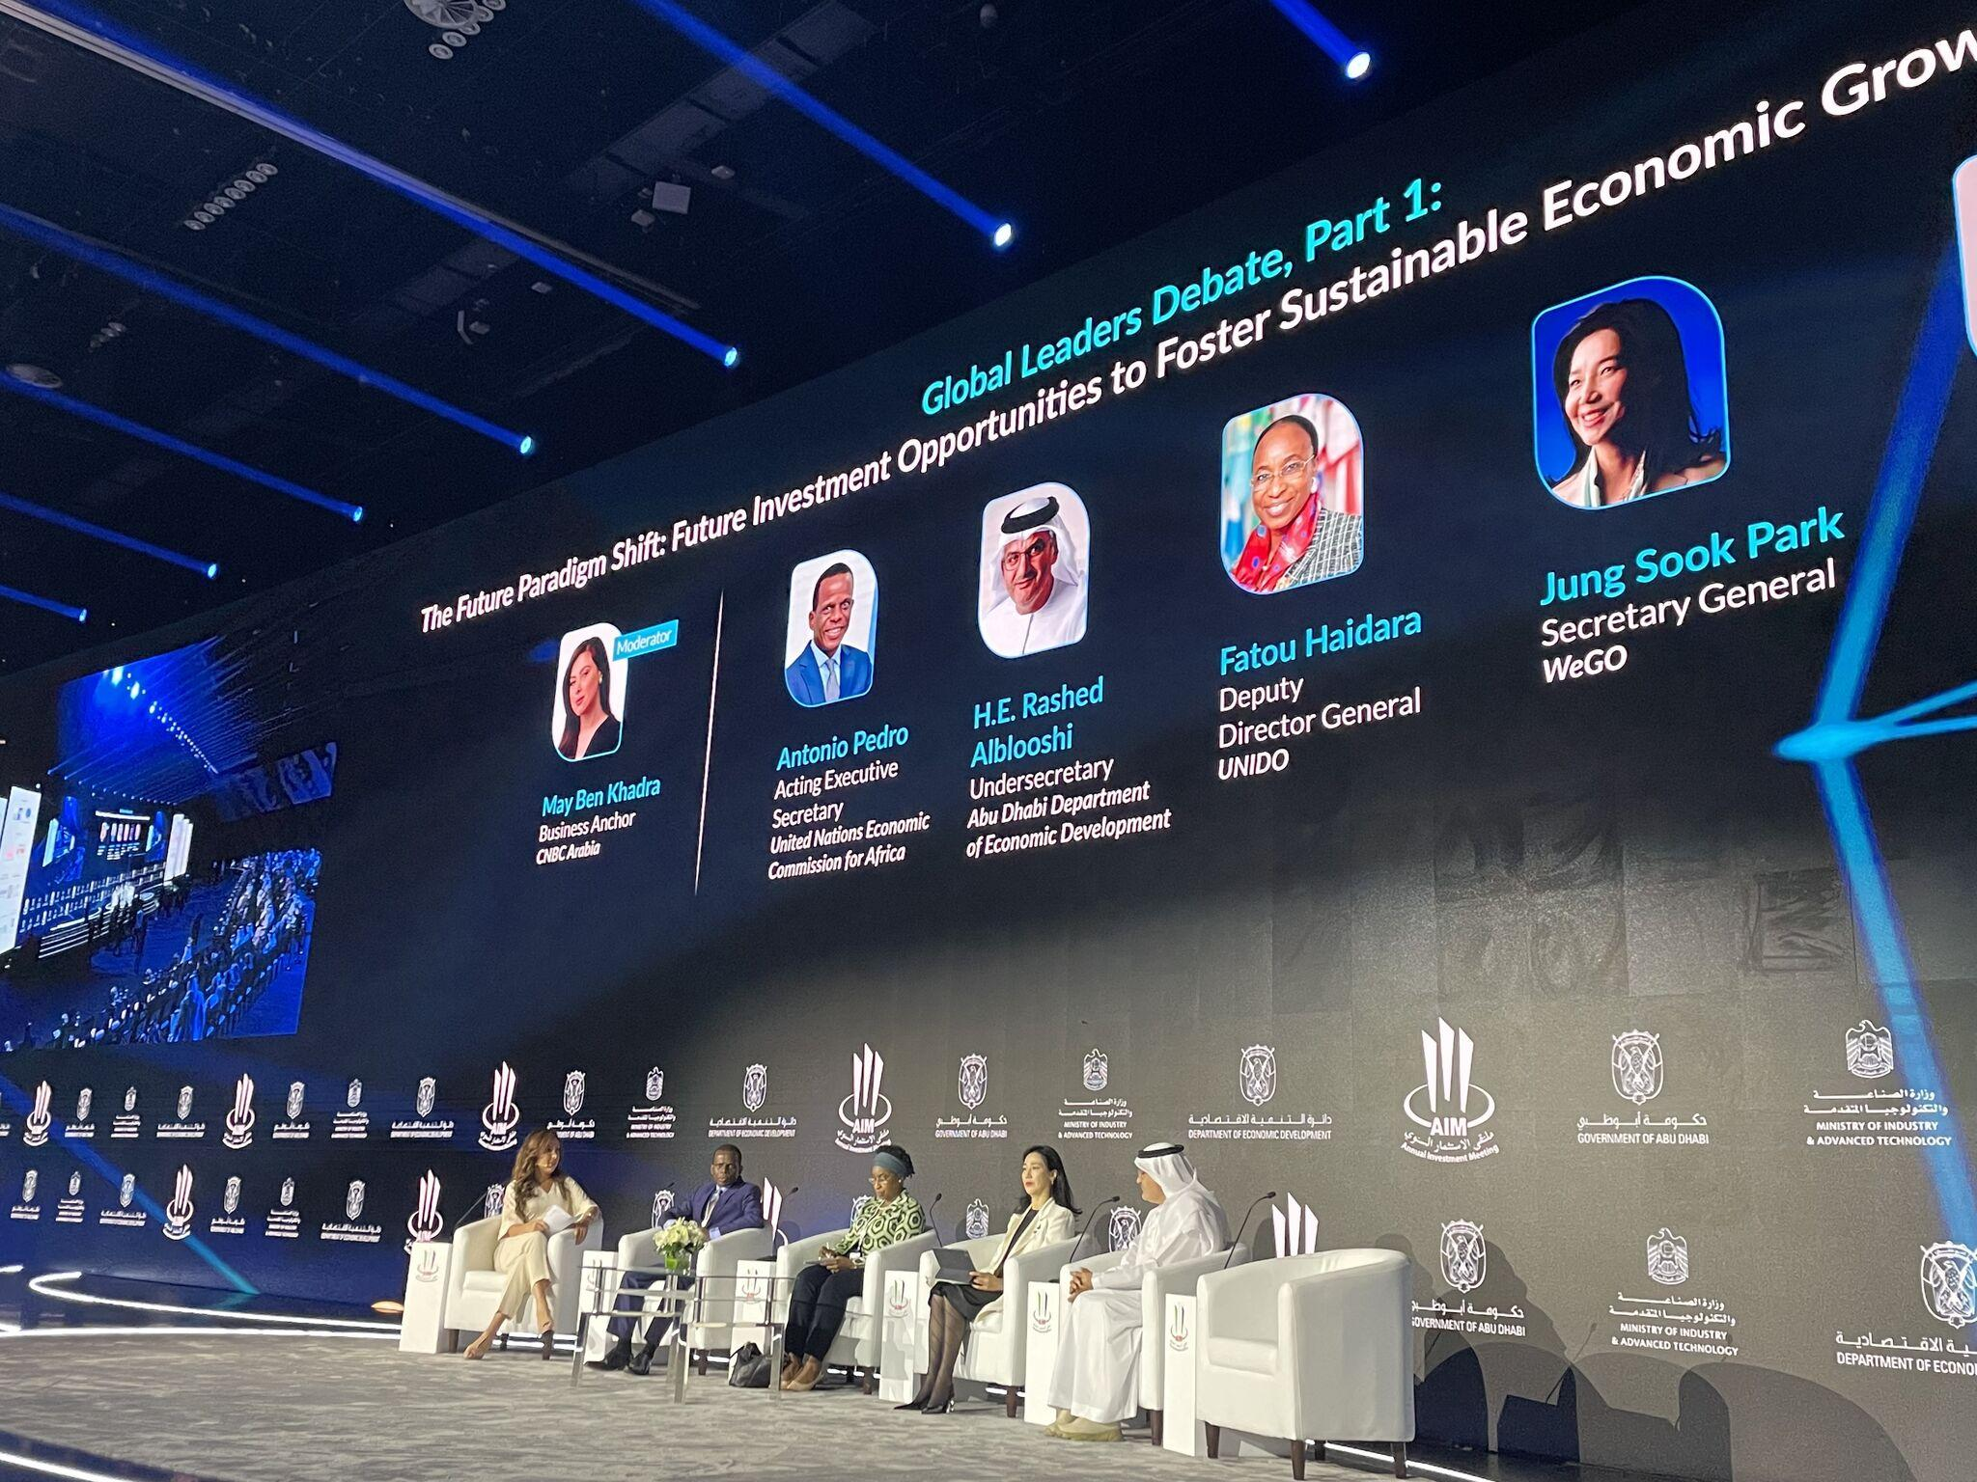
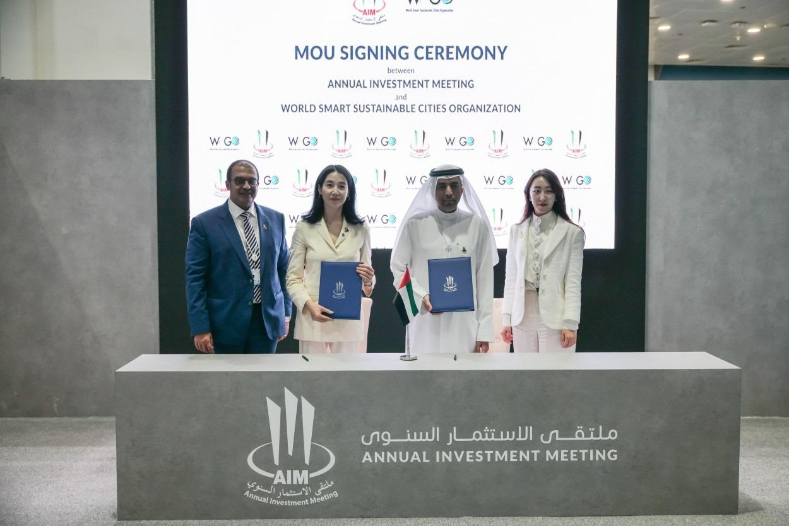
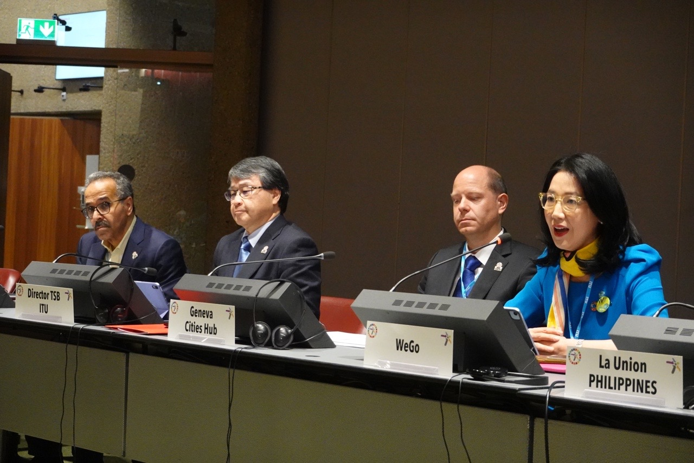
03 |
About WeGO
WeGO Activities 2024 - Knowledge Sharing & Networking
KNOWLEDGE-SHARING & NETWORKING
In line with the WeGO 2030 Master Plan, WeGO will continue its expansion and outreach strategy to further engage the global community. Leveraging opportunities held worldwide including conferences and forums, WeGO will share its vision and mission to identify new cities, corporates, and institutions that will become part of WeGO’s network for further collaboration.
CES 2024 | Jan 10-12 | Las Vegas
Smart City Summit & Expo 2024 | Mar 19-23 | Taipei
Smart City Expo Curitiba | Mar 20-22 | Curitiba
Annual Investment Meeting 2024 | May 07-09 | Abu Dhabi
Parliamentary Assembly of the Mediterranean General Assembly | May 15-16 | Lisbon
ITU World Summit on the Information Society 2024 | May 27-31 | Geneva
World Cities Summit 2024 | Jun 02-04 | Singapore
7th ASEAN Smart Cities Network Annual Meeting | Aug | Luang Prabang
World Smart City Expo 2024 | Sep 03-05 | Goyang
WeGO Executive Committee Meeting (EXCOM) | Sep 19-21 | Almaty
Seoul Smart Life Week | Oct 07-09 | Seoul
Smart City Expo World Congress 2024 | Nov 05-07 | Barcelona
COP29 | Nov 11-22 | Baku

Slide 24
03 |
About WeGO
WeGO Activities 2024 - Regional Activities
REGIONAL ACTIVITIES
Regional platforms for members to exchange knowledge and foster cooperation on smart city development.
Q2 | Latin America
Latin America Smart Cities Network (LASCN)
Africa Smart Cities Network (AFSCN)
Q3 | Africa
ASEAN Smart Cities Network (ASCN)
Q2 | Asia

Slide 25
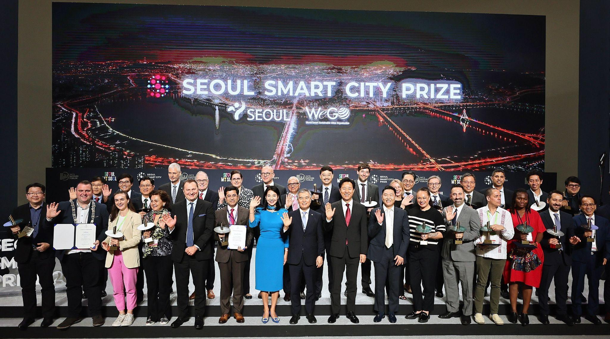
04 |
WeGO Activities
The 2nd Seoul Smart City Prize
The 2nd Seoul Smart City Prize
Seoul Smart City Prize, established in 2023 by WeGO and its President City, Seoul, is designed to promote an innovative yet inclusive smart city model that looks after underprivileged groups in the era of the Fourth Industrial Revolution that is driven by information and communication technology.
This year, the Seoul Smart City Prize Ceremony will be held during the Seoul Smart Life Week.
Tech-InnovaCity
Projects that focus on integration of innovative policies and technologies in all sectors of society and domains ranging from mobility, safety, welfare, environment, energy, culture, and governance.
Human-CentriCity
Projects that are designed to prioritize digital inclusion in smart city development, thereby overcoming or mitigating the digital divide, and that aim to serve specific target groups among the citizen population, such as the elderly, youth, and the disabled.
Leadership
Individuals that have demonstrated leadership in developing or promoting the innovative use of technology and data to impact the lives of global citizens.

Slide 26
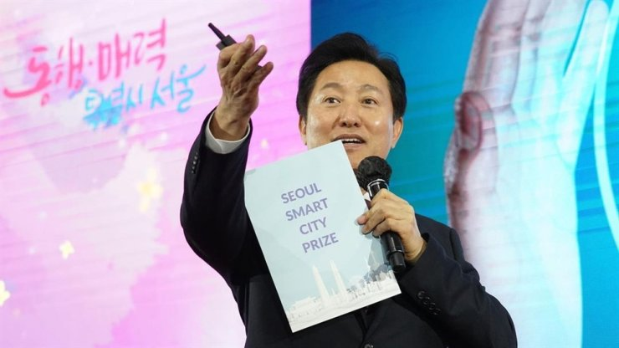
04 |
WeGO Activities
Seoul Smart Life Week
Seoul Smart Life Week
Seoul Smart Life Week will consist of exhibitions, forums, and the Seoul Smart City Prize Ceremony, showcasing innovative and human-centric technologies. The Week will also showcase Seoul’s smart city experience while opening the space for other cities and companies to share their innovative outcomes in smart city development and discuss future technology trends.
Seoul Smart Life Week
Theme: The Future of the Evolving Urban Life with Cutting-Edge Technology
Sub-Theme: A Preview of Urban Smart Life in Seoul
Dates: Oct. 9 (Wed) to 12 (Sat)
Host: Seoul Metropolitan Government
Program:
Exhibition of Cutting-edge Innovative Technologies
Seoul Smart City Prize Ceremony
International Forums and Conferences
Exhibitions: Immersive exhibitions of ICT technologies, products, human-centered technologies

Slide 27
04 |
WeGO Activities
The 2nd Seoul Smart City Prize
For Winners
Seoul Smart Life Week
Finalists from the Seoul Smart City Prize will 1) be recognized at the Seoul Smart City Prize Ceremony with the Prize trophy; 2) be provided with a 3m*3m booth to showcase their successful smart city development cases; 3) be invited to participate in forums to present awarded projects; 4) be offered opportunity to join the Seoul Smart Life Week tour programs
Seoul Smart City Prize Training Program
Finalists from the Seoul Smart City Prize will get the opportunity to receive a 4-week online and offline training program from the Seoul Human Resource Development Center, through a series of virtual live lectures and smart city tours in Seoul.
Seoul Smart City International Cooperation Program
This program, carried out in collaboration with the Seoul Urban Solutions Agency (SUSA), offers a unique opportunity to implement a smart city project, including assistance to conduct pre-feasibility studies, with a value of 200,000,000 KRW (approx. 150,000 USD) financial support allocated for this purpose.

Slide 28
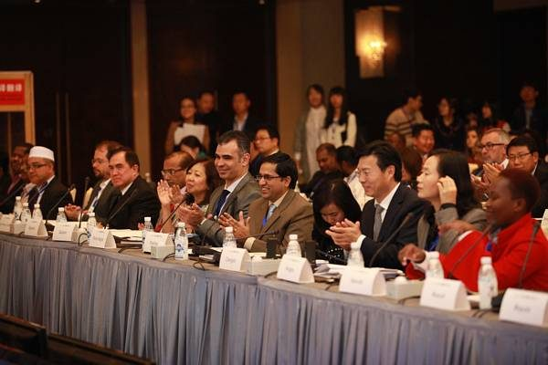
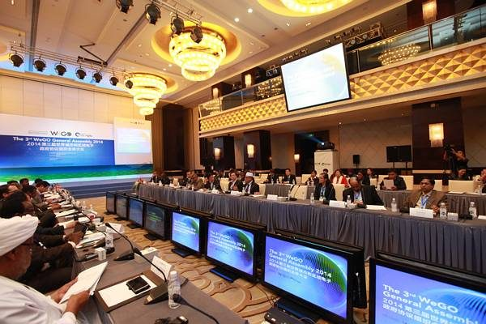
04 |
About WeGO
WeGO EXCOM 2025 Bidding Announcements
Host City for the WeGO 2025 Executive Committee Meeting
WeGO invites all local government members to put forward a bid to host the WeGO EXCOM Meeting 2025. This flagship events allow host cities to showcase their smart city initiatives and to explore partnership opportunities with other cities, prospective partners and stakeholders for joint initiatives and investments. Host city also enjoy global exposure by putting the city on the map as the leader in the smart city community.
The WeGO Executive Committee (EXCOM), WeGO’s main decision-making body, convenes annually to review the Secretariat’s activities and accomplishments in the past year and to decide on key agenda items guiding the organization’s direction for the future.
Bidding proposals will be accepted through secretariat@we-gov.org until June, 2024. The host city of the WeGO EXCOM Meeting 2025 will be selected during the EXCOM Meeting 2024 which will be hosted by Almaty City in September of this year.

Slide 29
Thank you
Kakim Danabayev, Senior Program Officer

